Slide 1

Wedding Planner
Guide : Dr. Maitri Jhaveri
Anmol Raval
MCA 6 - 22
A product of Tysu Infotech Pvt Ltd.

Slide 2
Internship Details
Company name : Tysu Infotech Pvt Ltd.
Website : www.tysuinfotech.com
External Guide : Mr. Jeet Prajapati
Project Definition :
MyShadiMyPlan Web App using Laravel Php Framework

Slide 3
What is MyShadiMyPlan ?
It is a wedding planning platform for customers and a opportunity for all the vendors who like to expand and efficiently manage their business.
Myshadimyplan.com is a B2C wedding vendor marketplace
A vendor centric System
3 types of users
Customers
Vendors
Admins

Slide 4
Benefits
Customers
Find a vendor as per the customer’s requirements
Variety of choices at their fingertips 35 categories
Get Ideas and tips for wedding from other users.
Share their own wedding experience .
Plan wedding without hassle.
One wedding stop
Vendors
Digital presence
Easy to share portfolio
Share the latest work and ideas
Periodic statistics and reports
Connects them to customers

Slide 5


Slide 6
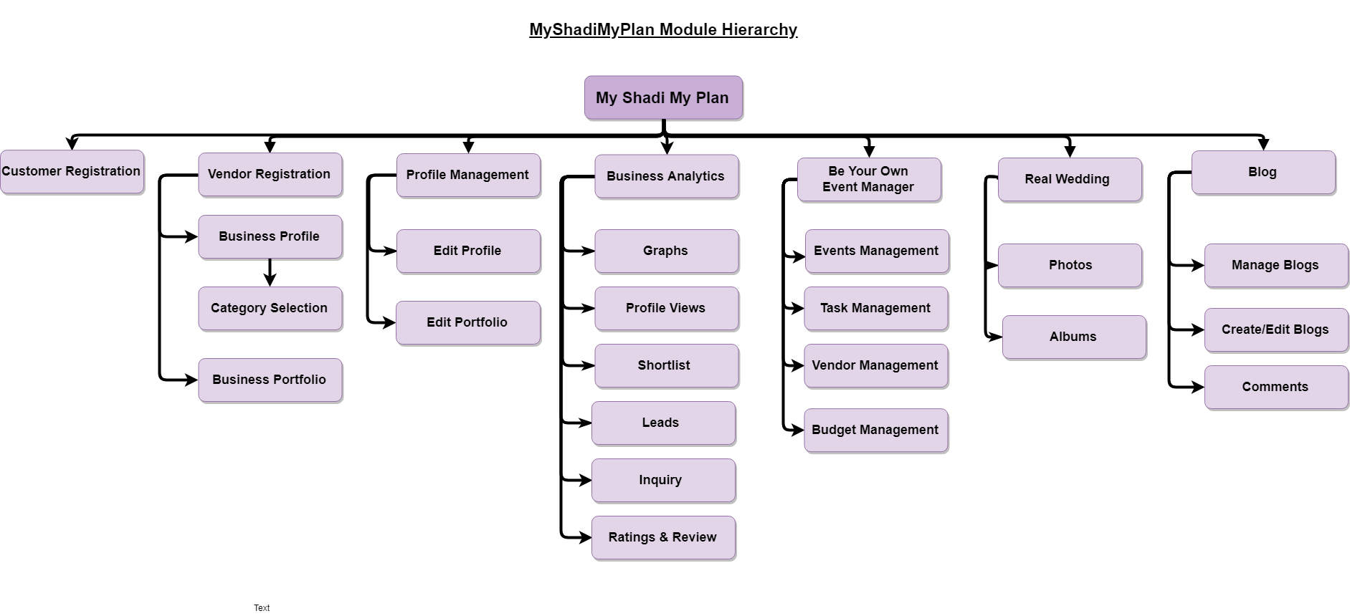

Slide 7
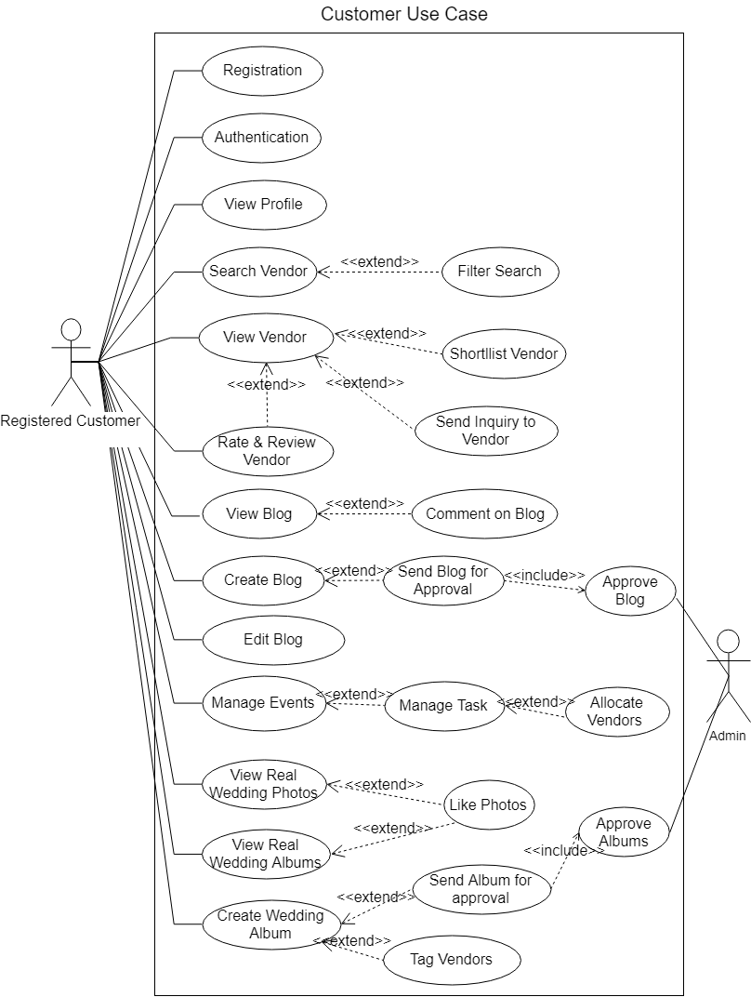

Slide 8
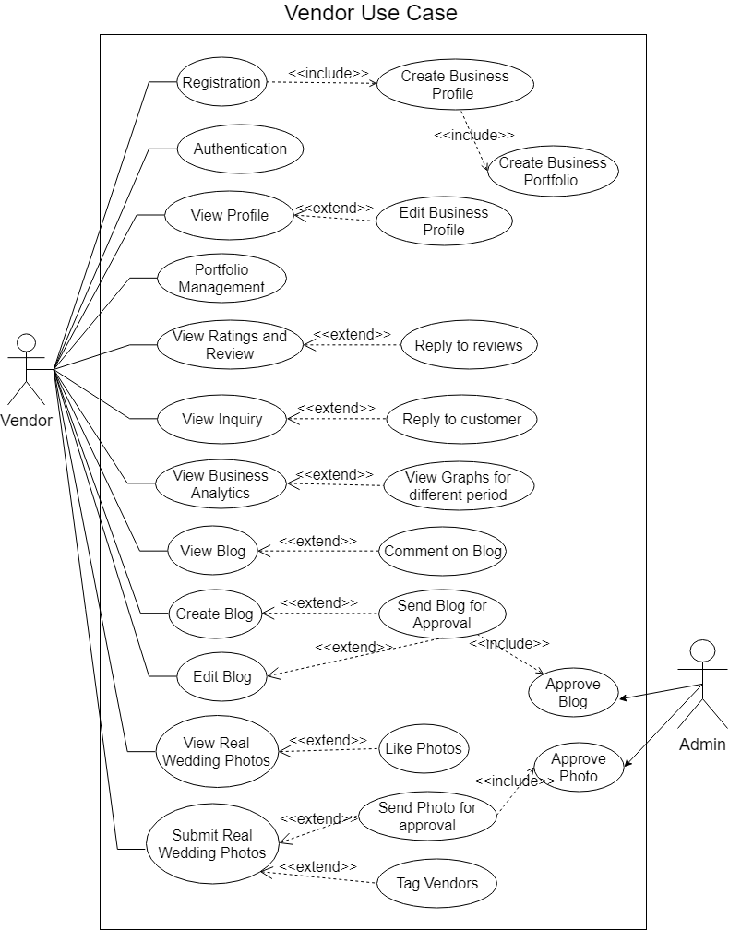

Slide 9
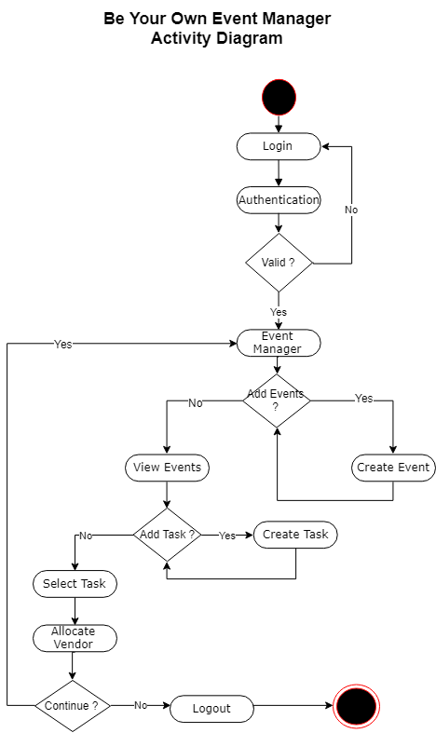

Slide 10
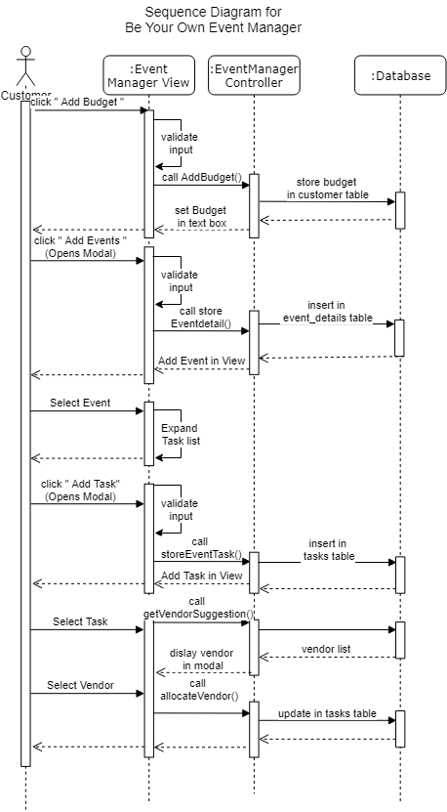

Slide 11
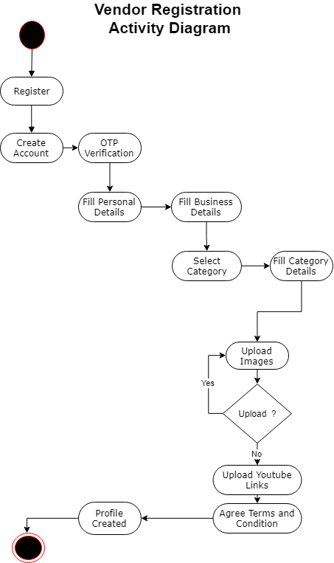

Slide 12
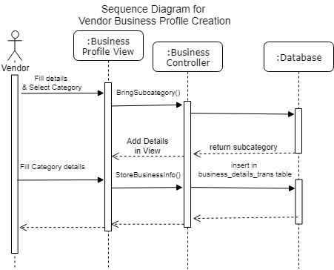

Slide 13
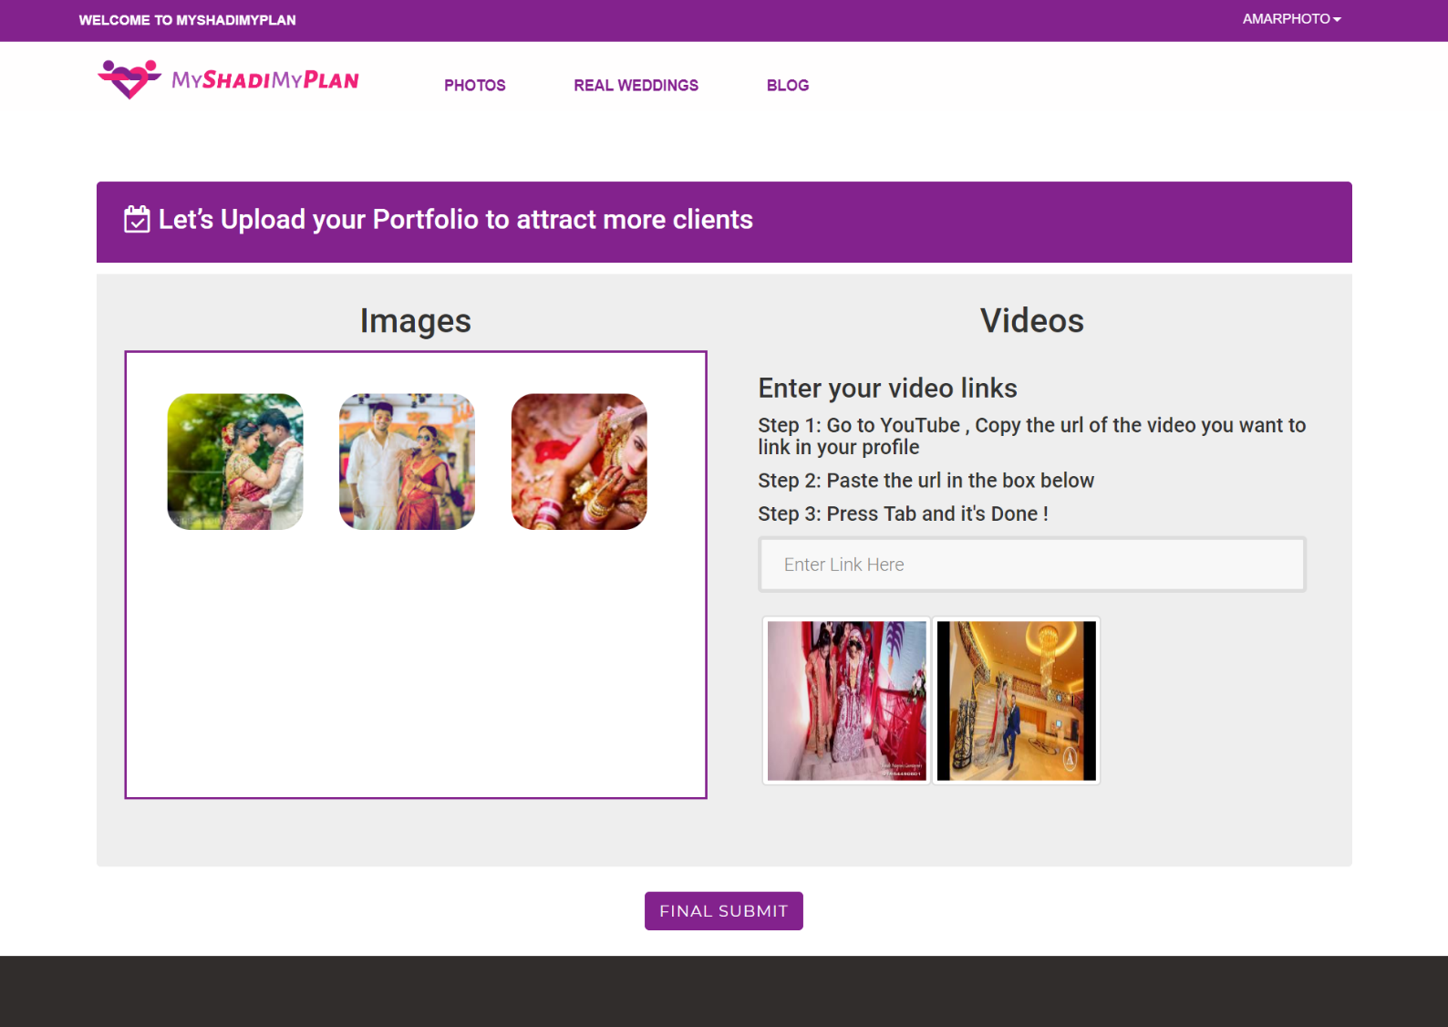

Slide 14
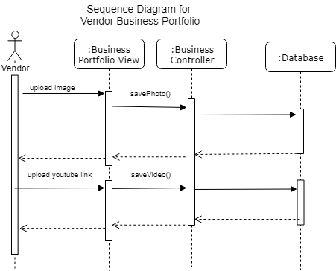

Slide 15
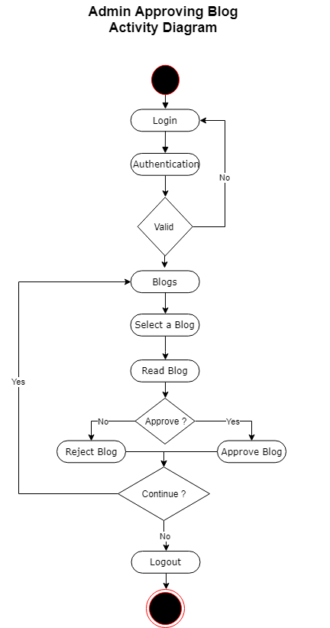

Slide 16
Class Diagram

Slide 17
Data Dictionary

Slide 18
Table name : users
Column | Type | Null | Comments
id (Primary) | int(10) | No | Primary key
username | varchar(191) | No | Username to login ,it will be unique
email | varchar(191) | No | Email id of the user
password | varchar(191) | No | Password to login
role | varchar(191) | No | Role of the user : vendor or customer
ip_add | varchar(191) | Yes | IP Address
remember_token | varchar(100) | Yes | Remember me token
created_at | timestamp | Yes
updated_at | timestamp | Yes

Slide 19
Table name : admin
Column | Type | Null | Comments
id (Primary) | int(10) | No | Primary key
user_name | varchar(191) | No | username to login in admin panel
password | varchar(191) | No | password to login in admin panel
role | varchar(191) | No | designation of the employee

Slide 20
Table name : categories_master
Column | Type | Null | Comments
id (Primary) | int(10) | No | Primary key
category_name | varchar(191) | No | Category Name
thumbnail | varchar(191) | No | Category Image name to display in thumbnail
created_at | timestamp | Yes
updated_at | timestamp | Yes

Slide 21
Table : sub_categories_master
Column | Type | Null | Comments
id (Primary) | int(10) | No | Primary key
sub_category_name | varchar(191) | No | Subcategory name
category_id | int(11) | Yes | Foreign Key : categories_master table
created_at | timestamp | Yes
updated_at | timestamp | Yes

Slide 22
Table name : city_master
Column | Type | Null | Comments
id (Primary) | int(10) | No | Primary key
city_name | varchar(191) | No | City Name
created_at | timestamp | Yes
updated_at | timestamp | Yes

Slide 23
Table name : customers
Column | Type | Null | Comments
id (Primary) | int(10) | No | Primary key
first_name | varchar(191) | No | First name of the customer
last_name | varchar(191) | No | Last name of the customer
phone | varchar(191) | Yes | Phone number
email | varchar(191) | No | Email address
user_id | int(10) | No | Foreign Key : users table
OTP_code | varchar(191) | Yes | OTP code generated randomly
phone_verifed | int(11) | Yes | Flag for Phone number verified
email_verifed | int(11) | Yes | Flag for Email id verified
total_budget | varchar(191) | Yes | Budget of the wedding
shareid | int(11) | No | Partner Share id
realWddingAlbum | varchar(191) | Yes | Album name of Real Wedding
profile_image | varchar(191) | No | Profile Image name
facebook_url | varchar(191) | Yes | Facebook Url
twitter_url | varchar(191) | Yes | Twitter Url
instagram_url | varchar(191) | Yes | Instagram Url
created_at | timestamp | Yes
updated_at | timestamp | Yes

Slide 24
Table name : vendors
Column | Type | Null | Comments
id (Primary) | int(10) | No | Primary key
first_name | varchar(191) | No | First name of the vendor
last_name | varchar(191) | No | Last name of the vendor
phone | varchar(191) | No | Phone number
phone_second | varchar(191) | Yes | Second Phone number
email | varchar(191) | No | Email Address
email_second | varchar(191) | Yes | Second Email Address
business_name | varchar(191) | Yes | Vendor's Business name
business_address | varchar(191) | Yes | Vendor's Business address
business_contact_no | varchar(191) | Yes | Business contact number

Slide 25
Table name : vendors
years_of_exp | int(4) | Yes | Years of experience
min_max_price | varchar(191) | Yes | Calculated minimum & maximum price on insert or update
min_max_price_second | varchar(191) | Yes | Calculated minimum & maximum price on insert or update
category_id | int(11) | Yes | Foreign key : categories_master table
country | varchar(191) | No
state | varchar(191) | No
city | int(11) | No
pincode | varchar(191) | No
profile_image | varchar(191) | No | Profile image name

Slide 26
Table name : vendors
cover_photo | varchar(191) | Yes | Cover image name
website_url | varchar(191) | Yes | website url of the vendor
instagram_url | varchar(191) | Yes | Vendor's Instagram url
fb_url | varchar(191) | Yes | Vendor's Facebook url
youtube_url | varchar(191) | Yes | Vendor's Youtube url
user_id | varchar(191) | No | Foreign Key :users table
OTP_code | varchar(191) | No | OTP code
phone_verified | varchar(191) | No | Phone verified flag
email_verified | varchar(191) | No | Email Address verified Flag

Slide 27
Table name : vendors
personal_detail_flag | varchar(191) | Yes | personal detail complete flag
business_detail_flag | varchar(191) | Yes | Business detail complete flag
rating | decimal(3,1) | Yes | Average Rating calculated as per insert in review table and stored here
terms_condition_flag | int(11) | No | terms and condition accepted flag
created_at | timestamp | Yes
updated_at | timestamp | Yes

Slide 28
Table name : photos_of_vendor
Column | Type | Null | Comments
id (Primary) | int(10) | No | Primary key
vendor_id | int(11) | Yes | Foreign Key : vendors table
user_id | int(11) | Yes | Foreign Key : users table
photo_name | varchar(191) | Yes | Image name
created_at | timestamp | Yes
updated_at | timestamp | Yes

Slide 29
Table name : videos_of_vendor
Column | Type | Null | Comments
id (Primary) | int(11) | No | Primary key
user_id | int(11) | No | Foreign Key : users table
video_link | varchar(500) | No | Youtube Video Link
video_id | varchar(100) | No | Video is extracted from the video_link
created_at | timestamp | Yes
updated_at | timestamp | Yes

Slide 30
Table name : business_details_trans
Column | Type | Null | Comments
id (Primary) | int(10) | No | Primary key
sub_categories_id | int(11) | Yes | Foreign Key : sub_categories_master table
category_id | int(11) | No | Foreign Key : categories_master table
vendor_id | int(11) | Yes | Foreign Key : users table
user_id | int(11) | Yes | Foreing Key : users_table
vendors_outfit_shop_type | varchar(191) | Yes | Shop or Venue Type
outfit_new_or_rent | varchar(191) | No | New or Rent flag
price_range | varchar(191) | Yes | Price range with '-' seperated
capacity_for_fixed | int(11) | Yes | Fixed capacity for venue
capacity_for_floating | int(11) | Yes | Floating capacity for venue

Slide 31
Table name : business_details_trans
food_policy | varchar(191) | Yes | Food Policy of the vendor
decor_policy | varchar(191) | Yes | Decor Policy of the vendor
parking_policy | varchar(191) | Yes | Parking Policy of the vendor
travel_policy | varchar(191) | Yes | Travel Policy of the vendor
payment_policy | varchar(191) | Yes | Payment Policy of the vendor
shipping_policy | varchar(191) | Yes | Shipping Policy of the vendor
trial_policy | varchar(191) | Yes | Trial Policy of the vendor
available_at | varchar(191) | Yes | Available at ',' separated

Slide 32
Table name : business_details_trans
venues_on_rent_range | varchar(191) | Yes | Rent venue Price range with '-' seperated
venues_rooms_availability | int(11) | Yes
venues_rooms__price | varchar(191) | Yes | Room Price range with '-' seperated
venues_plate_range | varchar(191) | Yes | Plate Price range with '-' seperated
space_type | varchar(191) | Yes | Space type
specialization | varchar(191) | Yes | Specialization of the Vendor
transportation_capacity | varchar(191) | Yes | Transportation Capacity
created_at | timestamp | Yes
updated_at | timestamp | Yes

Slide 33
Table name : blog
Column | Type | Null | Comments
id (Primary) | int(10) | No | Primary key
blog_title | varchar(191) | Yes | Blog Heading
blog_text | varchar(191) | Yes
blog_cover_image | varchar(191) | Yes | Cover Image name
user_id | int(11) | No | Foreign Key : users table
user_role | varchar(15) | Yes | User role
blog_approved_status | int(11) | Yes | Blog approved flag
reject_reason | varchar(191) | Yes | recject reason by admin
category | varchar(100) | Yes | Foreign key : categories_master table
tags | varchar(500) | Yes | Tags stored ',' seperated
created_at | timestamp | Yes
updated_at | timestamp | Yes

Slide 34
Table name : block_transaction
Column | Type | Null | Comments
id (Primary) | int(11) | No | Primary key
blog_id | int(11) | Yes | Foreign Key : blog table
user_id | int(11) | Yes | Foreign Key : users table
block_text | varchar(2000) | No | Paragraph content
block_image | varchar(191) | Yes | Paragraph image
created_at | timestamp | Yes
updated_at | timestamp | Yes

Slide 35
Table name : comments
Column | Type | Null | Comments
id (Primary) | int(10) | No | Primary key
blog_id | int(11) | No | Foreign Key : blog table
comment_text | varchar(500) | No | Comment Text
user_id | int(11) | No | Foreign Key : users table
customer_id | int(11) | Yes | Foreign Key : customer table
created_at | timestamp | Yes
updated_at | timestamp | Yes

Slide 36
Table name : event_detail
Column | Type | Null | Comments
id (Primary) | int(10) | No | Primary key
customer_id | int(11) | No | Foreign Key : customers table
user_id | int(11) | No | Foreign Key : users table
event_number | int(11) | No | Event number for the customer
budget_amount | varchar(191) | No | Event Budget
custom_event_name | varchar(191) | No | Event Name
event_date | date | No | Event date
created_at | timestamp | Yes
updated_at | timestamp | Yes

Slide 37
Table name : task_master
Column | Type | Null | Comments
id (Primary) | int(10) | No | Primary key
ed_id | int(11) | No | Foreign Key : event_details table
customer_id | int(11) | Yes | Foreign key : customers table
task_name | varchar(191) | No | Task Name (Category Name)
task_budget | varchar(191) | Yes | Task Budget
vendor_for_task | varchar(191) | Yes | Foreign key : vendors table
created_at | timestamp | Yes
updated_at | timestamp | Yes

Slide 38
Table name : realwedding
Column | Type | Null | Comments
id (Primary) | int(11) | No | Primary key
user_id | int(11) | No | Foreign Key : users table
user_role | varchar(11) | No | User role : customer or vendor
image_text | varchar(501) | Yes | Image description
image_name | varchar(64) | No | Image name
album_name | varchar(191) | Yes | Album name(Customer)
status | int(11) | Yes | if 0= Pending 1=approved , 2=rejected
category | varchar(100) | Yes | Category name
tags | varchar(500) | Yes | tags ',' seperated
likes_count | int(15) | Yes | Likes count updated on every like
created_at | timestamp | No
updated_at | timestamp | No

Slide 39
Table name : like_realwedding
Column | Type | Null | Comments
id (Primary) | int(11) | No | Primary key
realwedding_id | int(11) | No | Foreign Key : realwedding table
user_id | int(11) | No | Foreign Key : users table
created_at | timestamp | No
updated_at | timestamp | No

Slide 40
Table name : vendor_tag_realwedding
Column | Type | Null | Comments
id (Primary) | int(11) | No | Primary key
user_id | varchar(11) | No | Foreign Key : users table
vendor_id | varchar(11) | No | Foreign Key : vendors table
real_photo_id_albumname | varchar(100) | No | Foreign Key : realwedding table
created_at | timestamp | No
updated_at | timestamp | No

Slide 41
Table name : shortlist
Column | Type | Null | Comments
id (Primary) | int(10) | No | Primary key
vendor_id | varchar(191) | No | Foreign Key : vendors table
customer_id | varchar(191) | No | Foreign Key : customers table
category_id | varchar(191) | No | Foreign Key : categories_master table
user_id | varchar(191) | No | Foreign Key : users table ( user id of vendor)
created_at | timestamp | Yes
updated_at | timestamp | Yes

Slide 42
Table name : review
Column | Type | Null | Comments
id (Primary) | int(11) | No | Primary key
user_id | int(11) | No | Foreign Key : users table
vendor_id | int(11) | No | Foreign Key : vendors table
review_text | varchar(500) | No | Review text written by customer
rating | int(11) | No | Rating given by user
reply | varchar(500) | Yes | Reply text given by vendor
created_at | timestamp | No
updated_at | timestamp | No

Slide 43
Table name : inquiry
Column | Type | Null | Comments
id (Primary) | int(11) | No | Primary key
customer_id | int(11) | No | Foreign Key : users table
vendor_id | int(11) | No | Foreign Key : vendors table
event_date | date | Yes | Event date
message | varchar(250) | No | Inquiry message
seen_flag | int(11) | Yes | notification seen flag
phone | varchar(15) | No | Phone number if updated
created_at | timestamp | No
updated_at | timestamp | No

Slide 44
Table name : leads
Column | Type | Null | Comments
id (Primary) | int(11) | No | Primary key
vendor_id | varchar(11) | No | Foreign Key : vendors table
customer_id | varchar(11) | No | Foreign Key : customers table
created_at | timestamp | No
updated_at | timestamp | No

Slide 45
Table name : vendor_profile_view
Column | Type | Null | Comments
id (Primary) | int(11) | No | Primary key
customer_id | varchar(11) | No | Foreign Key : customers table
vendor_id | varchar(11) | No | Foreign Key : vendors table
created_at | timestamp | No
updated_at | timestamp | No

Slide 46
Screenshots

Slide 47
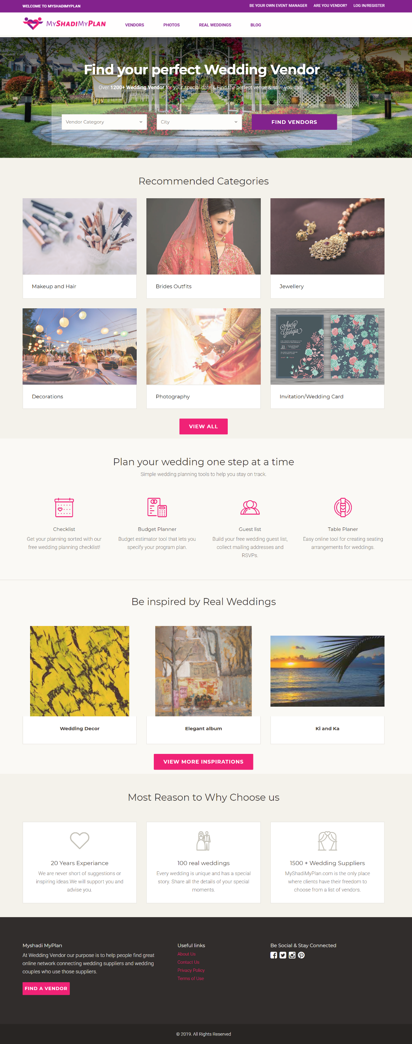

Home Page

Slide 48
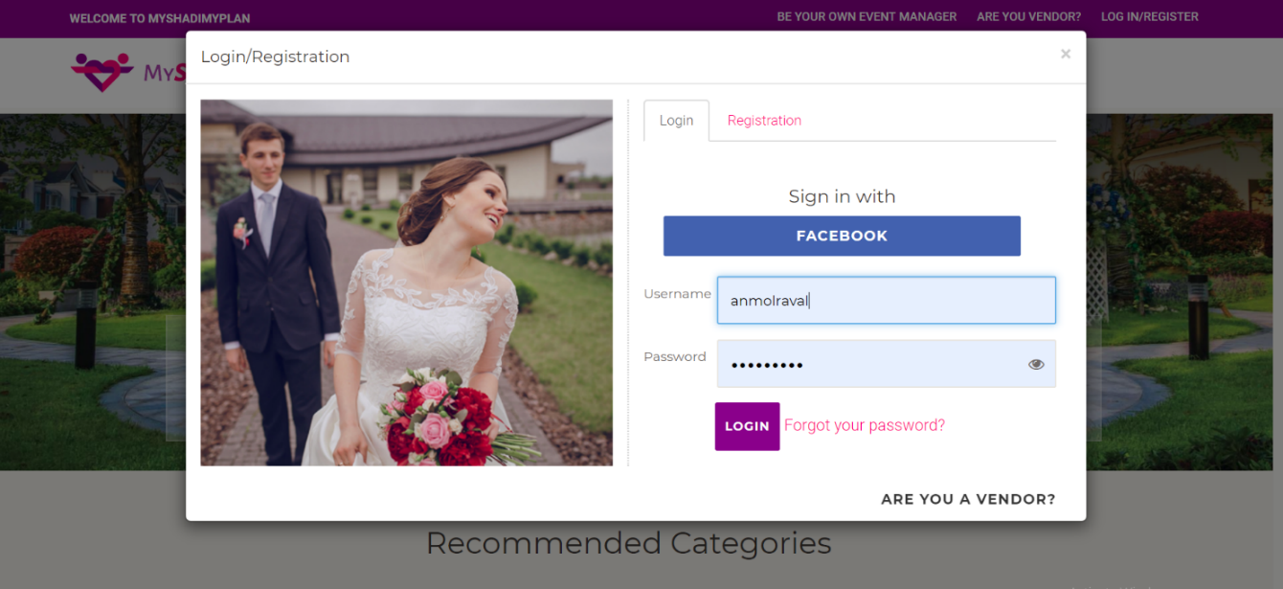
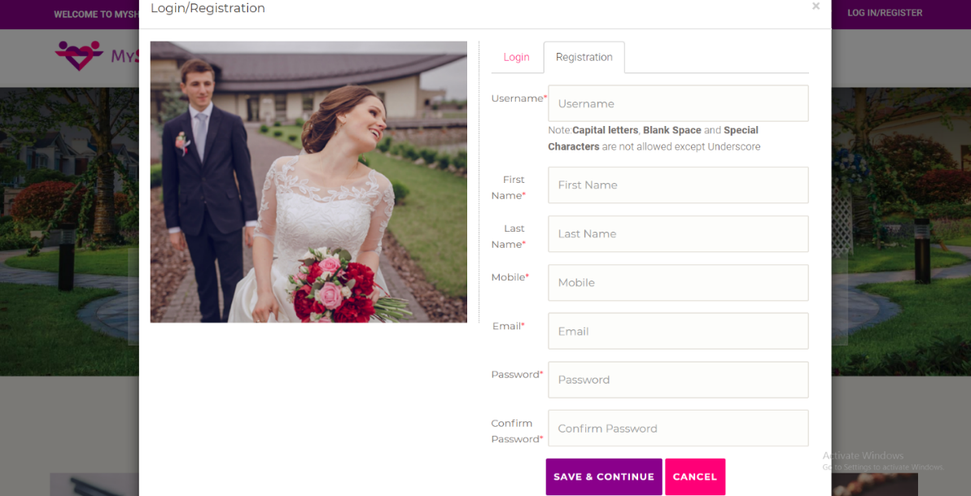
Login and Register Popup

Slide 49
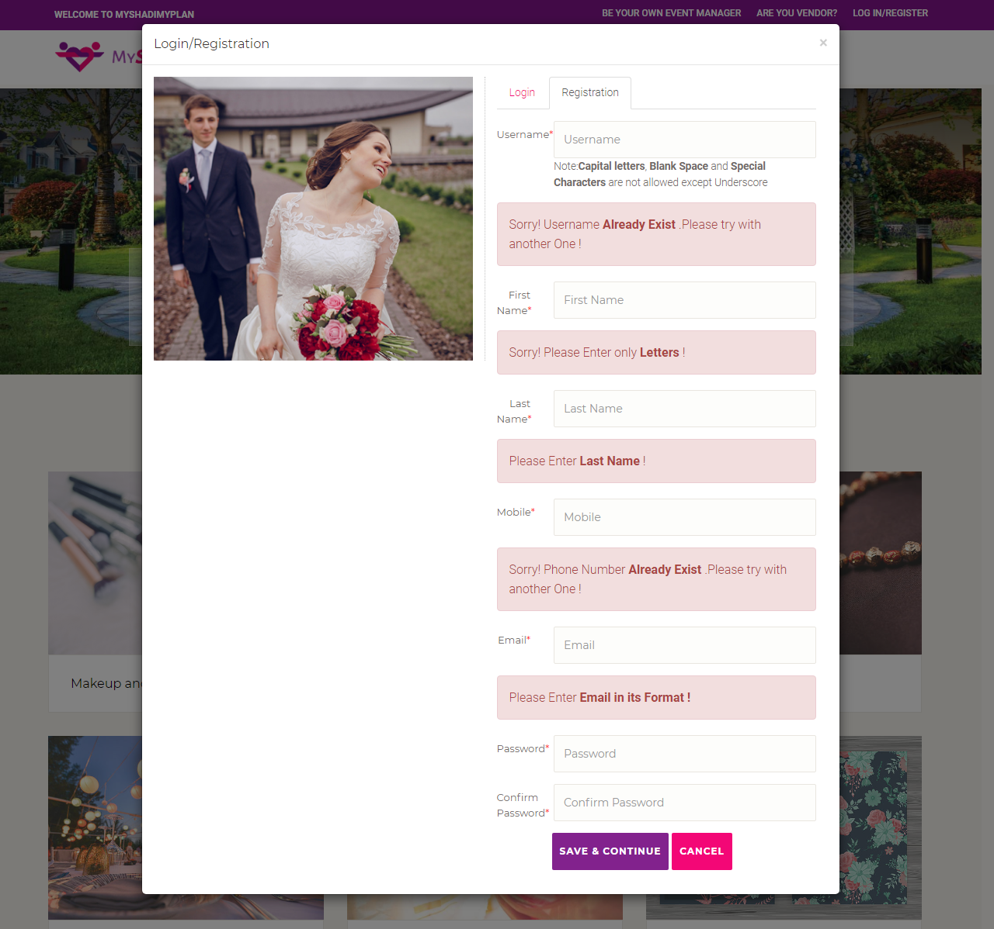

Slide 50
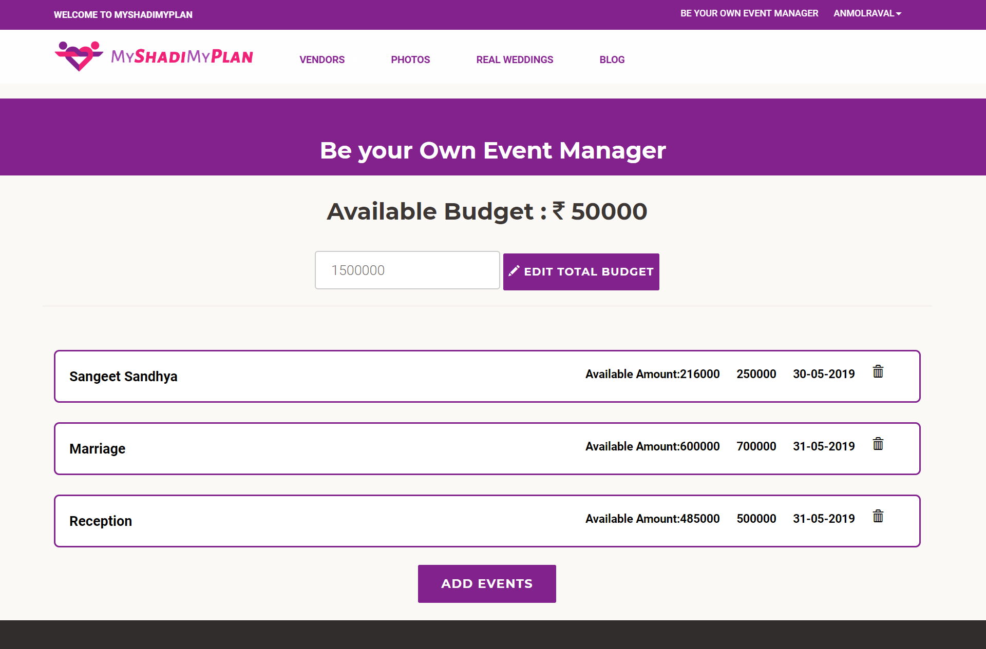
Event Manager

Slide 51
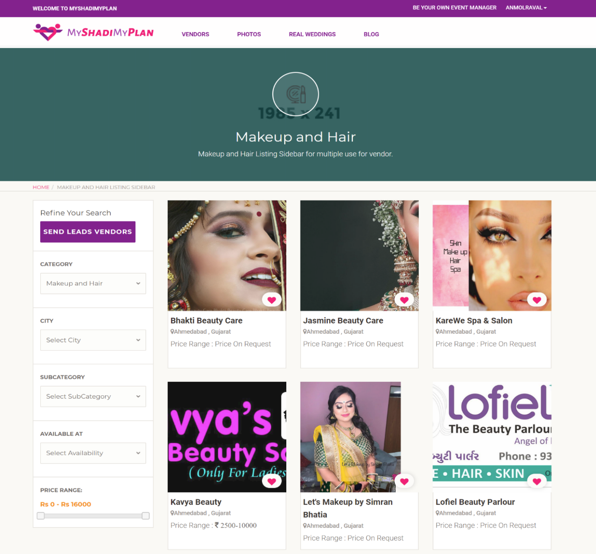
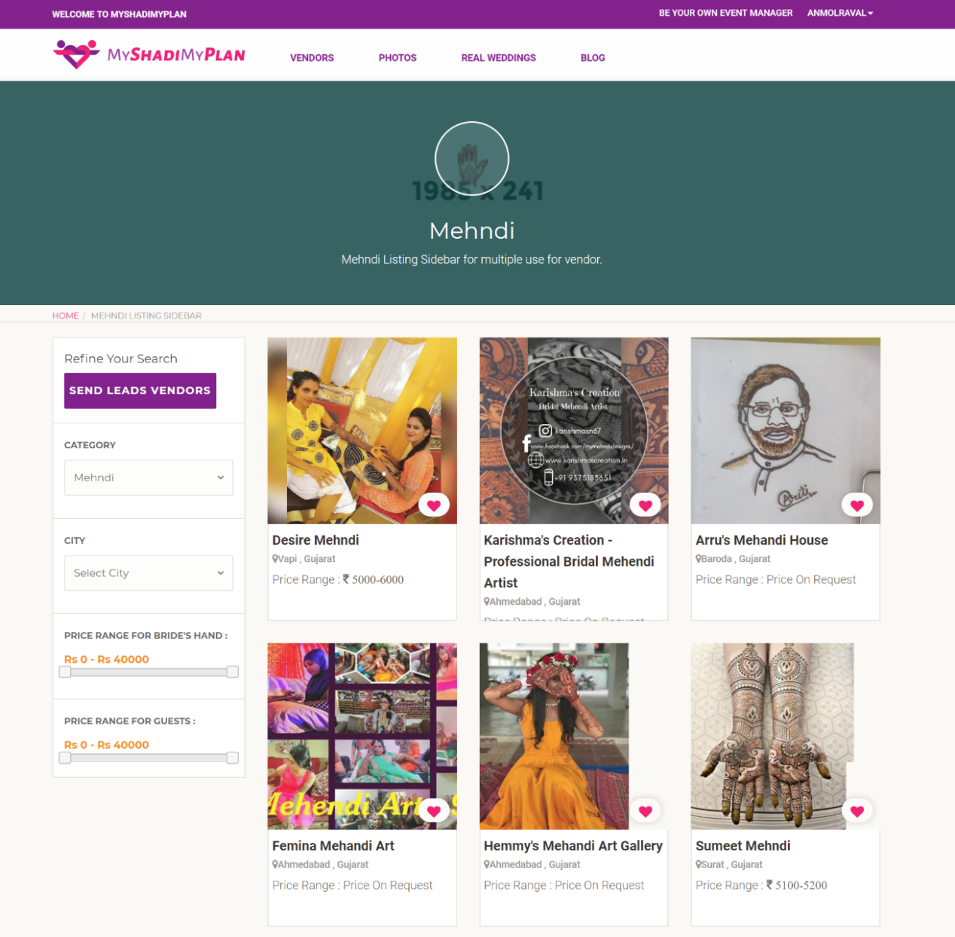
Browse Vendor

Slide 52
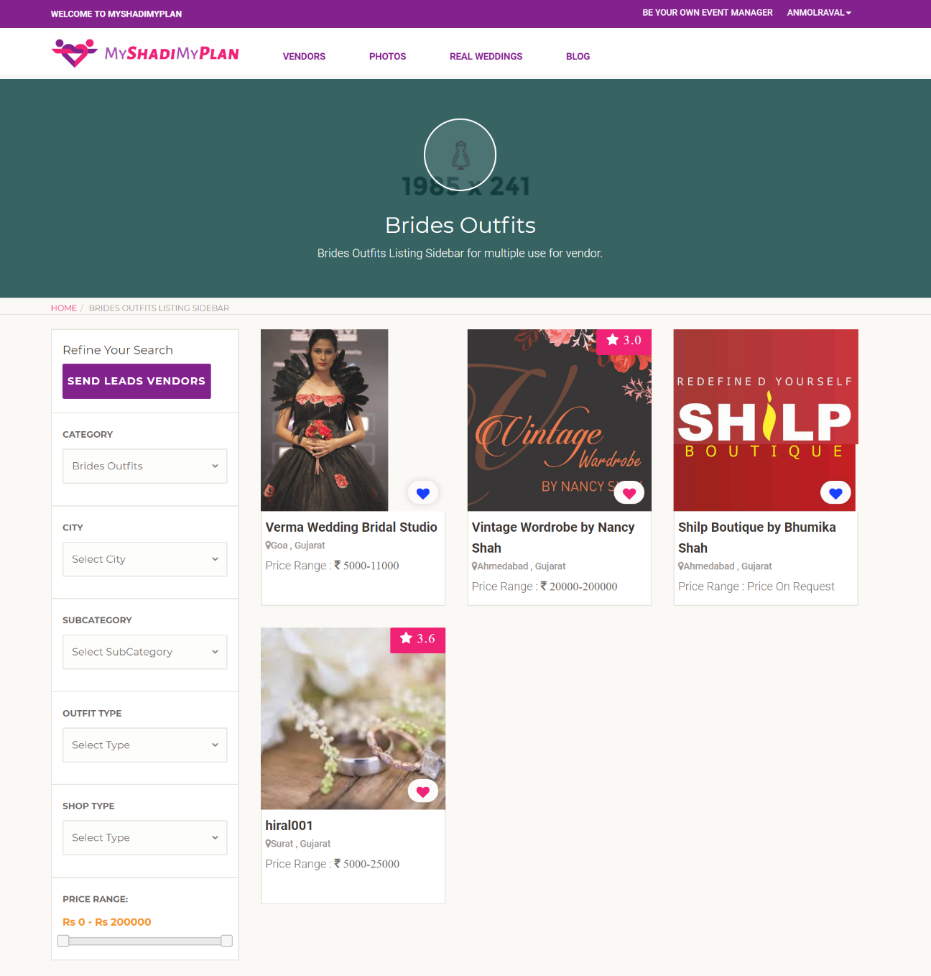
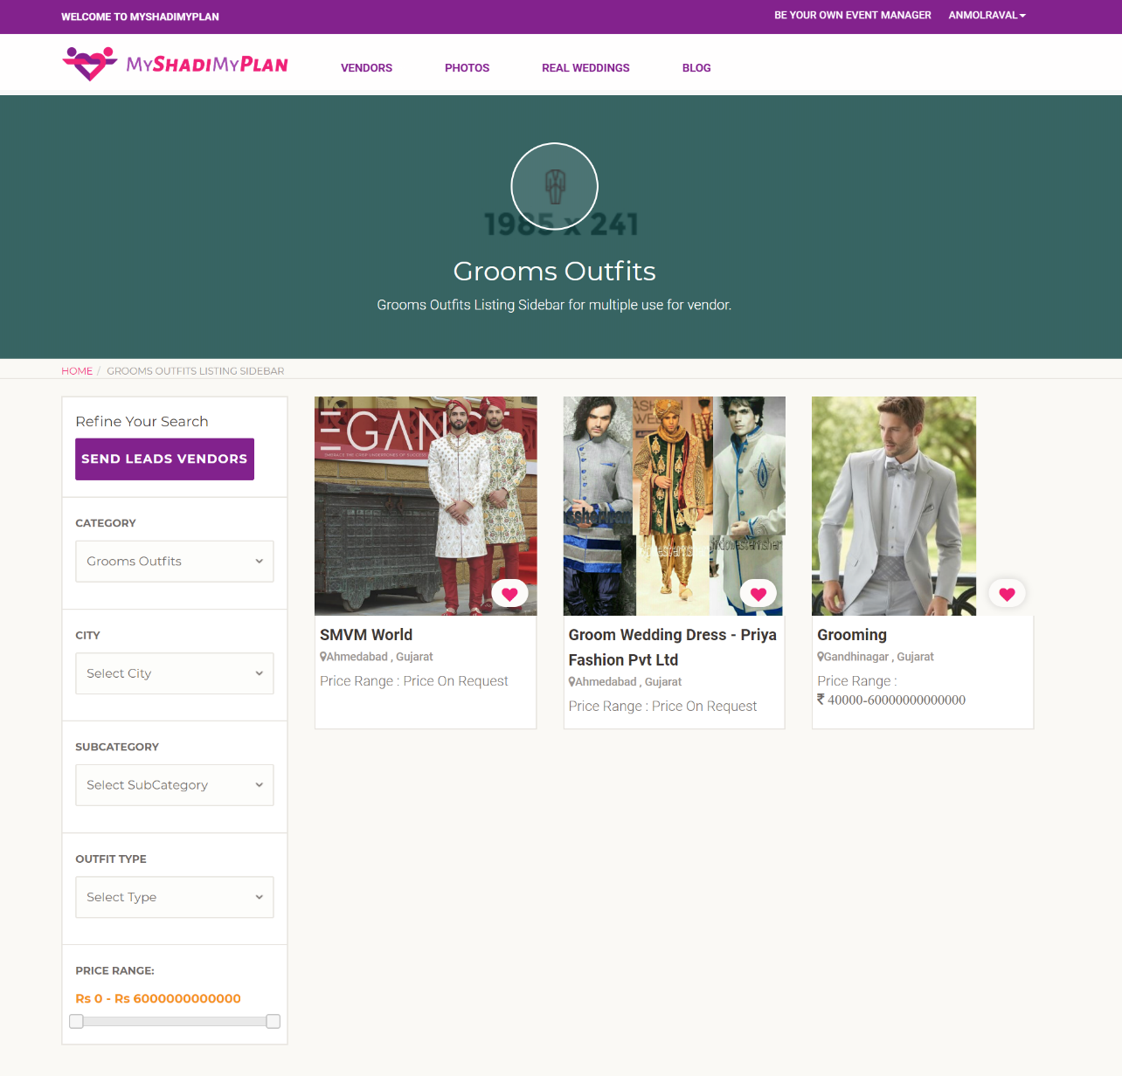

Slide 53
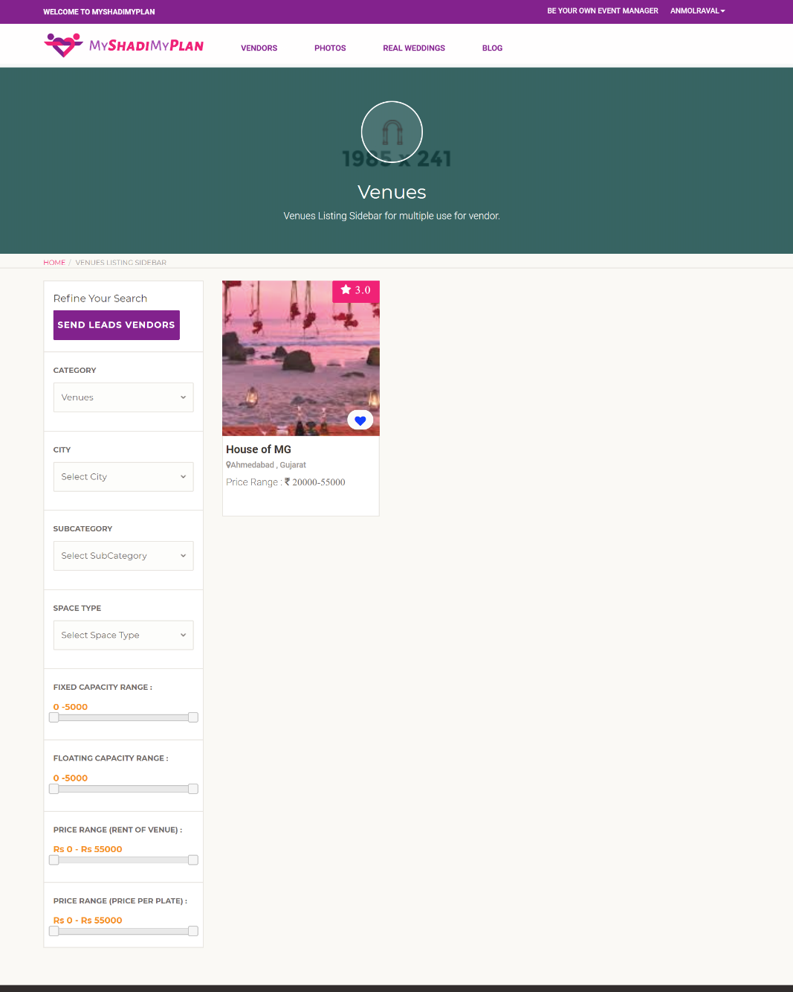
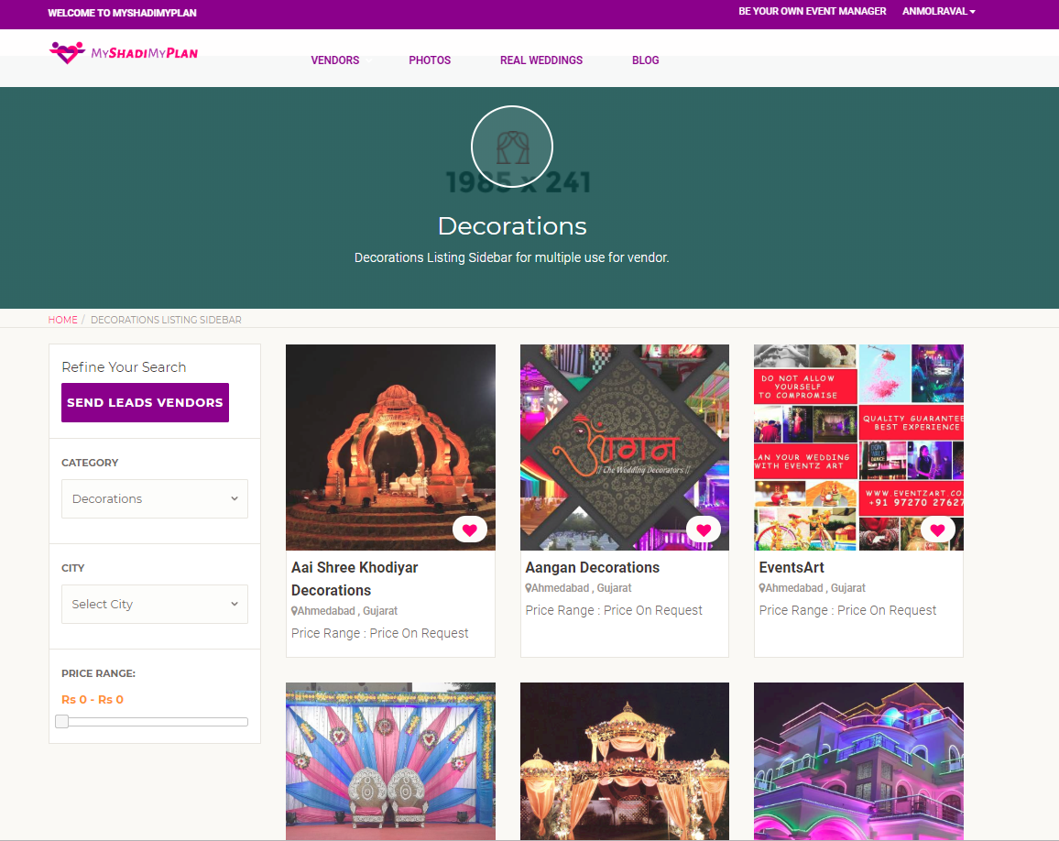

Slide 54
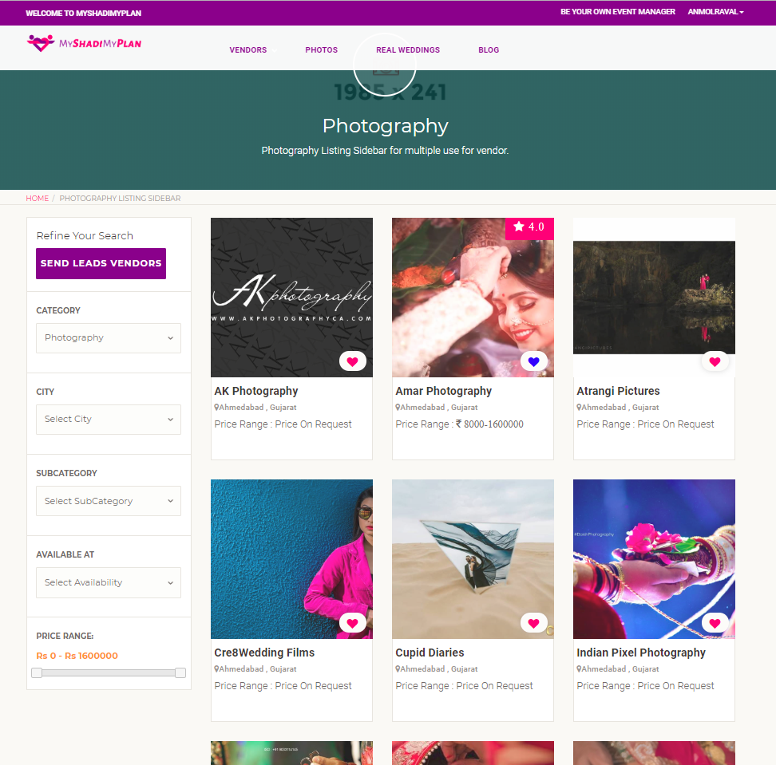
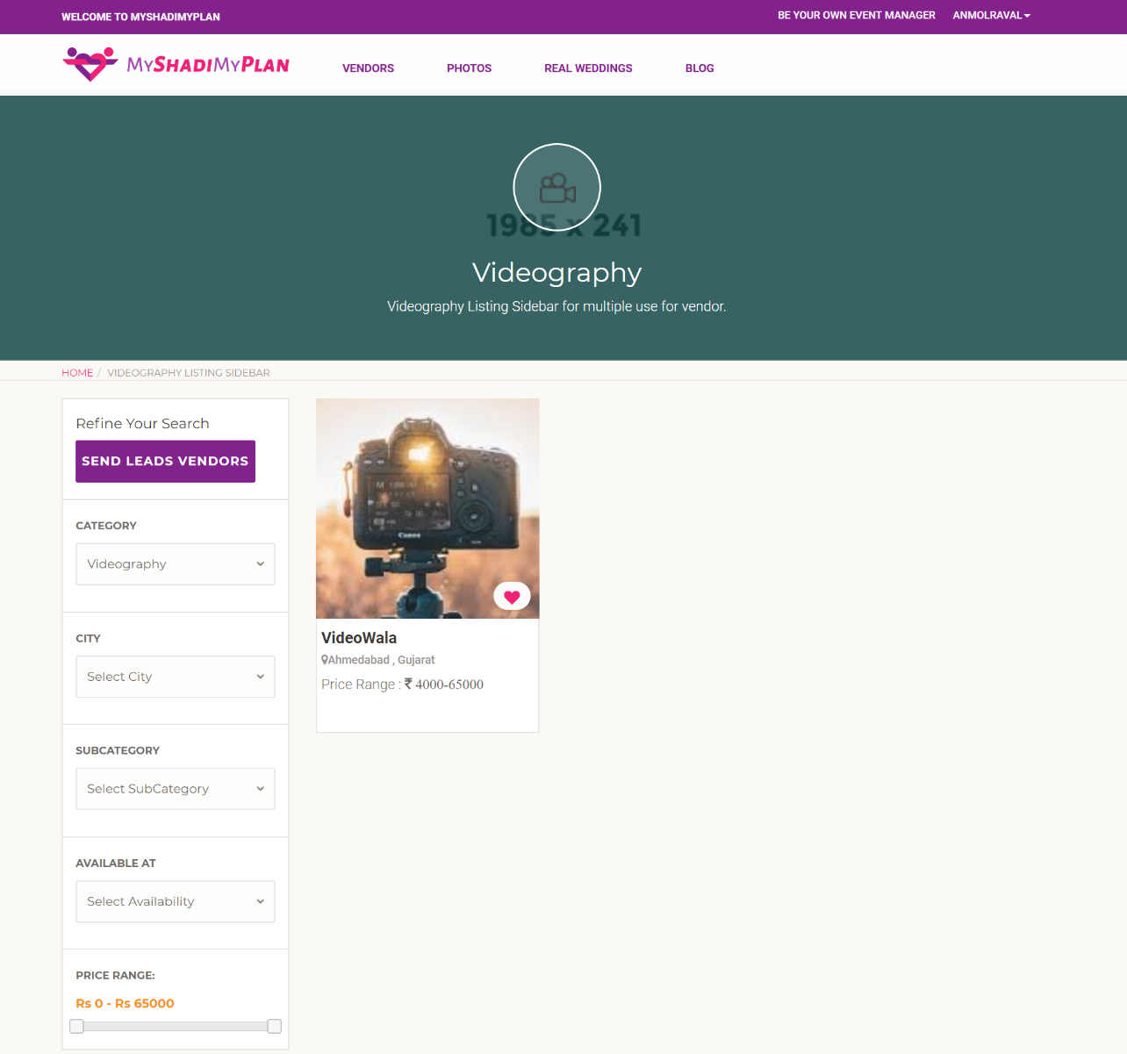

Slide 55
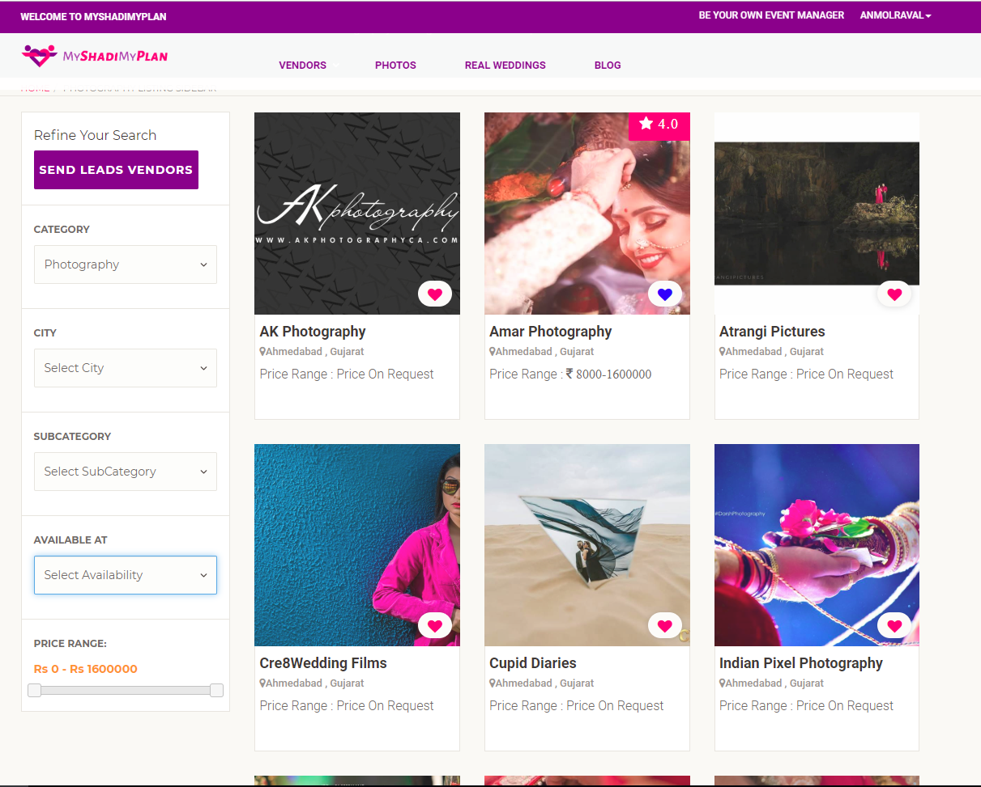
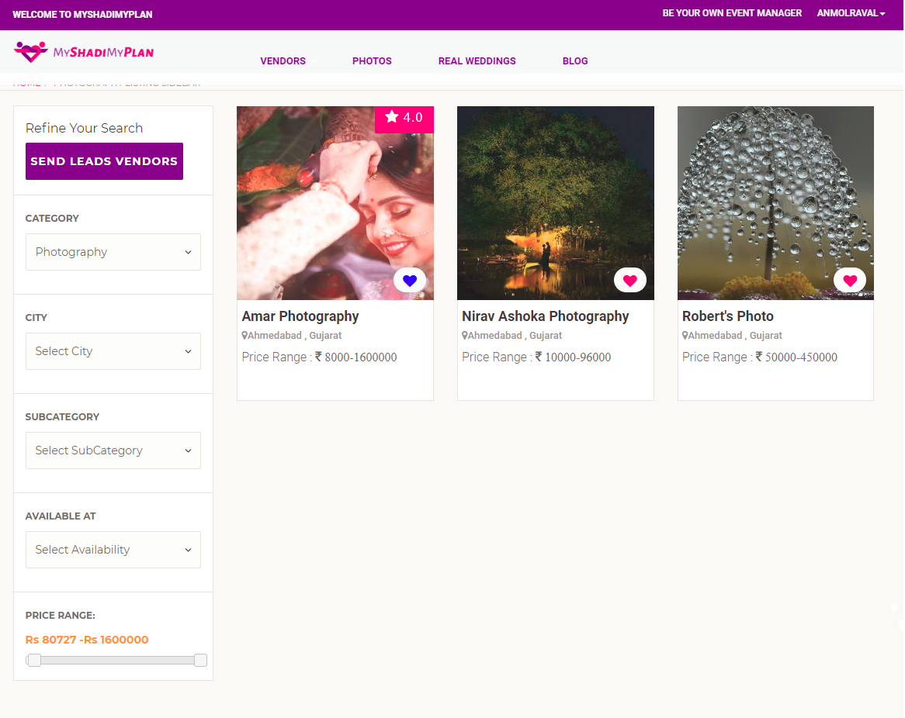
Filter by price range

Slide 56
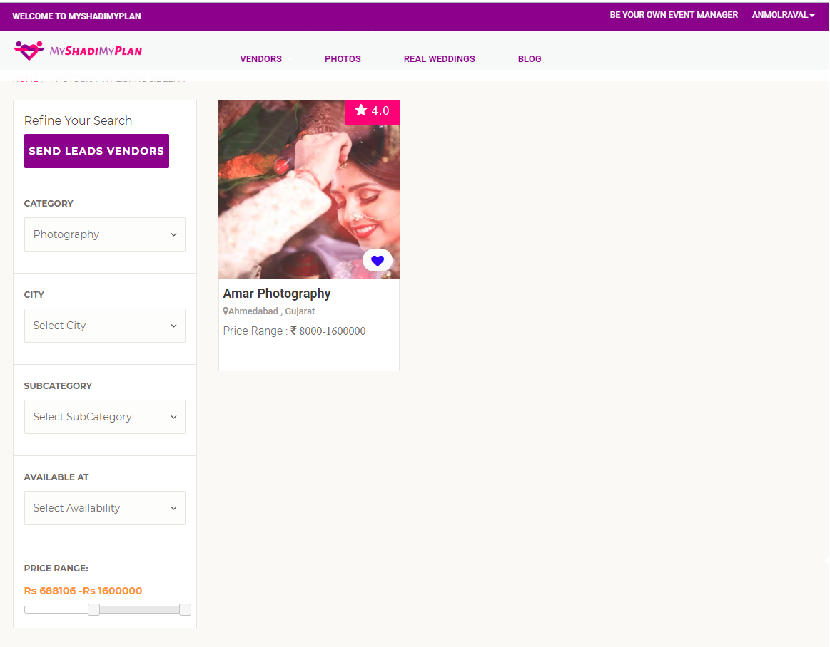

Slide 57
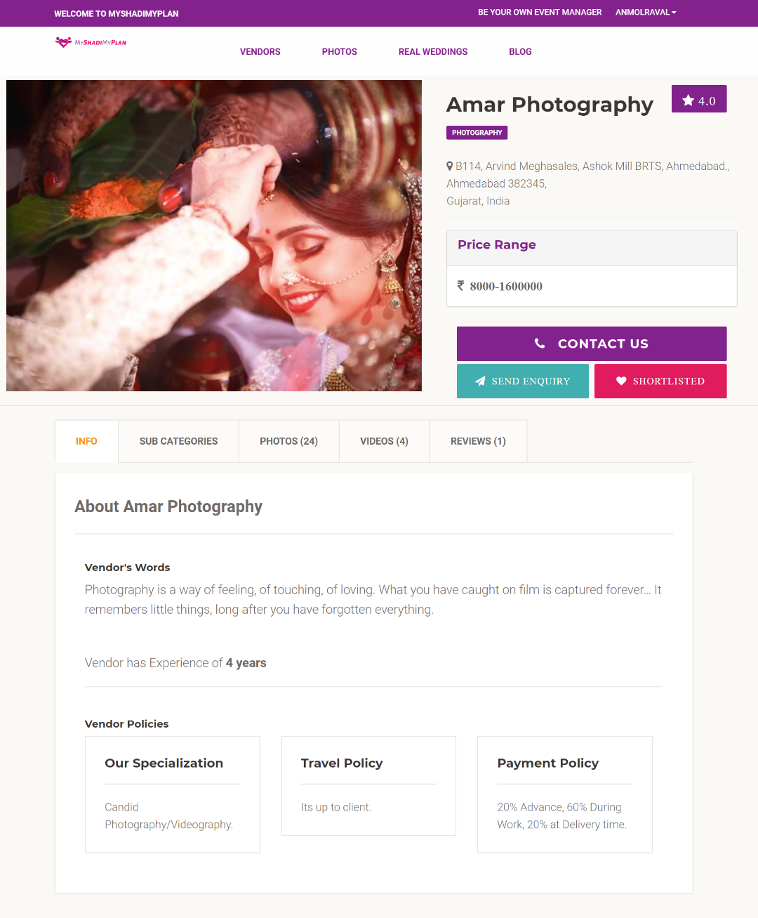
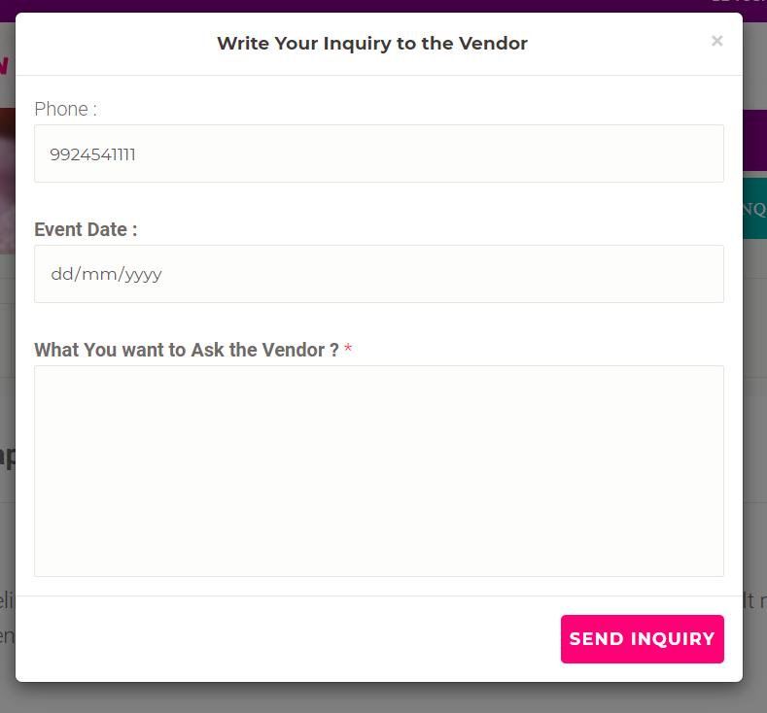
Vendor Profile View

Slide 58
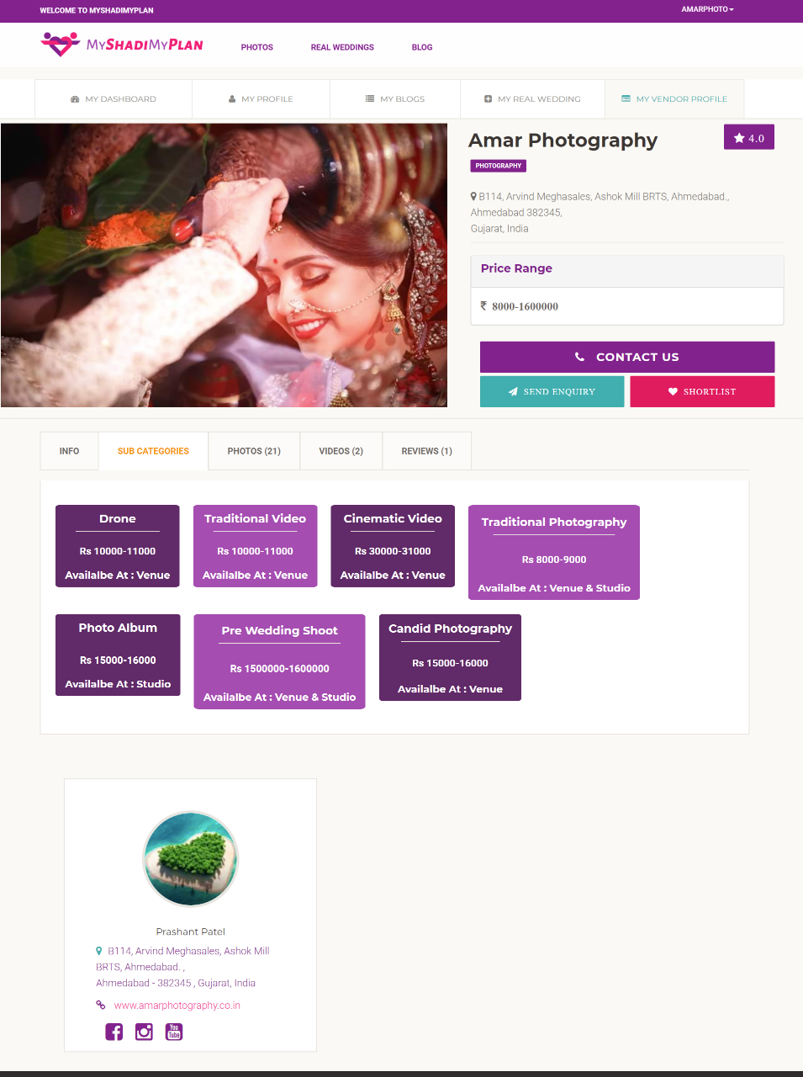
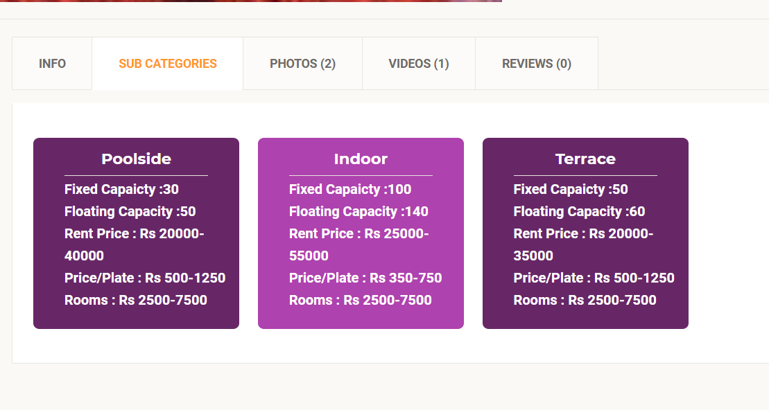
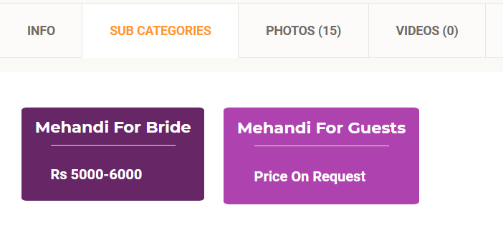
Vendor Profile View Subcategory Tab

Slide 59
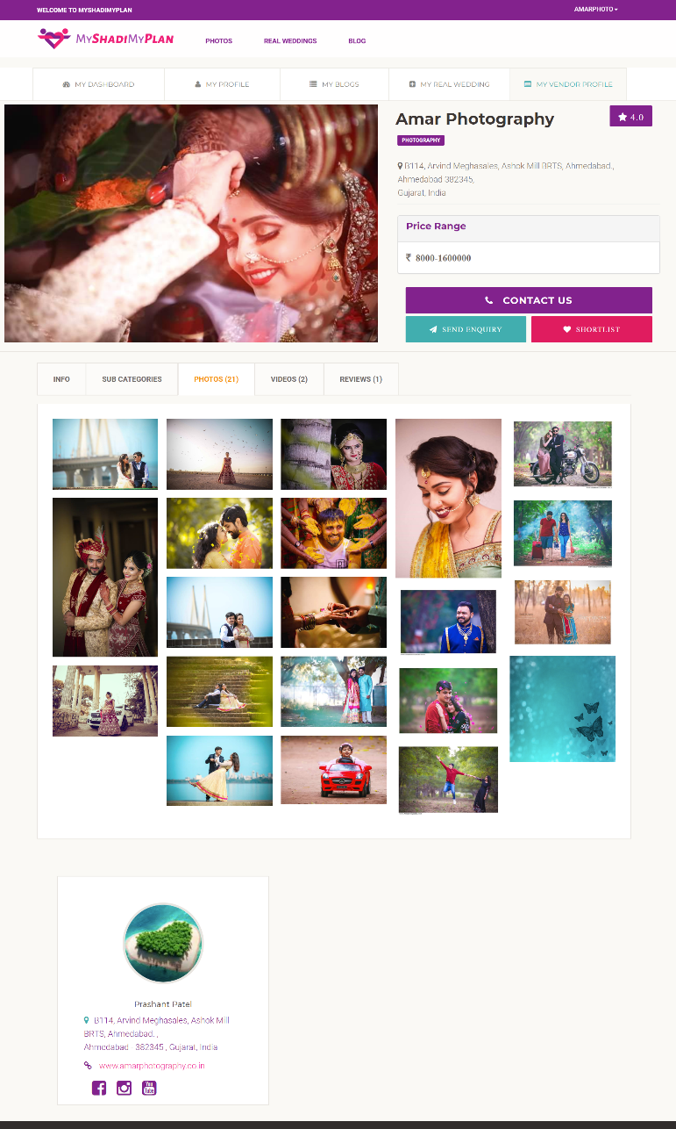
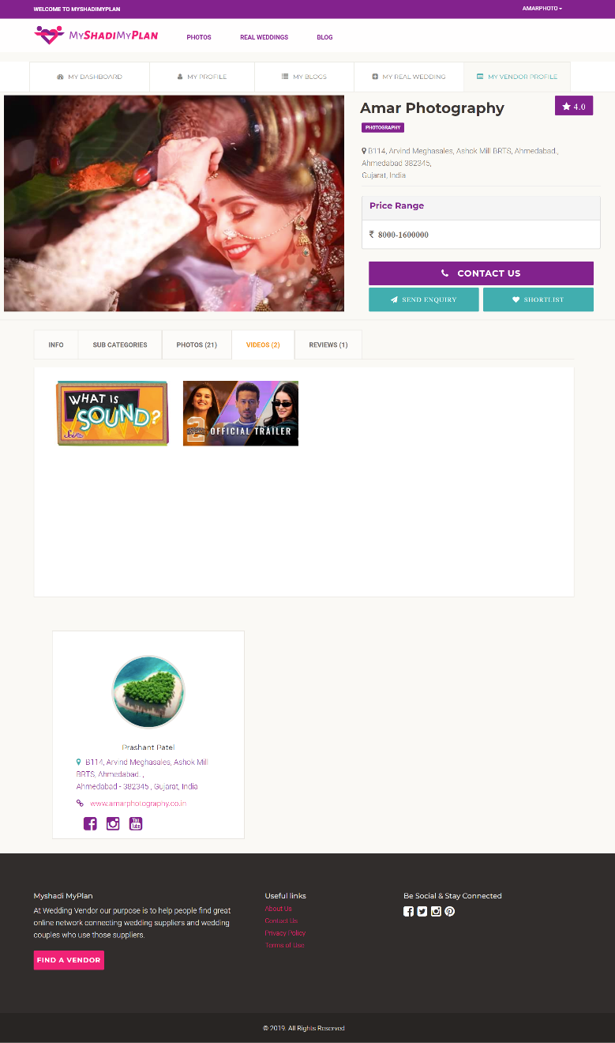
Vendor Profile View

Slide 60
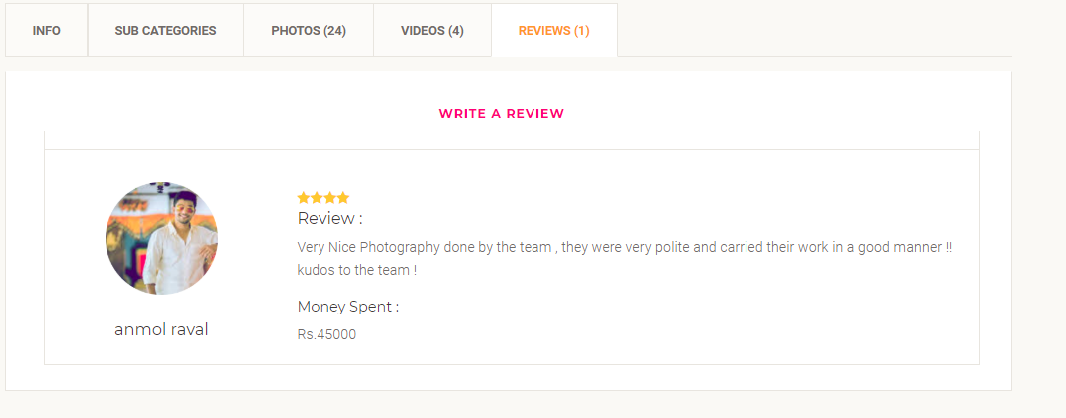
Vendor Profile Review Tab

Slide 61
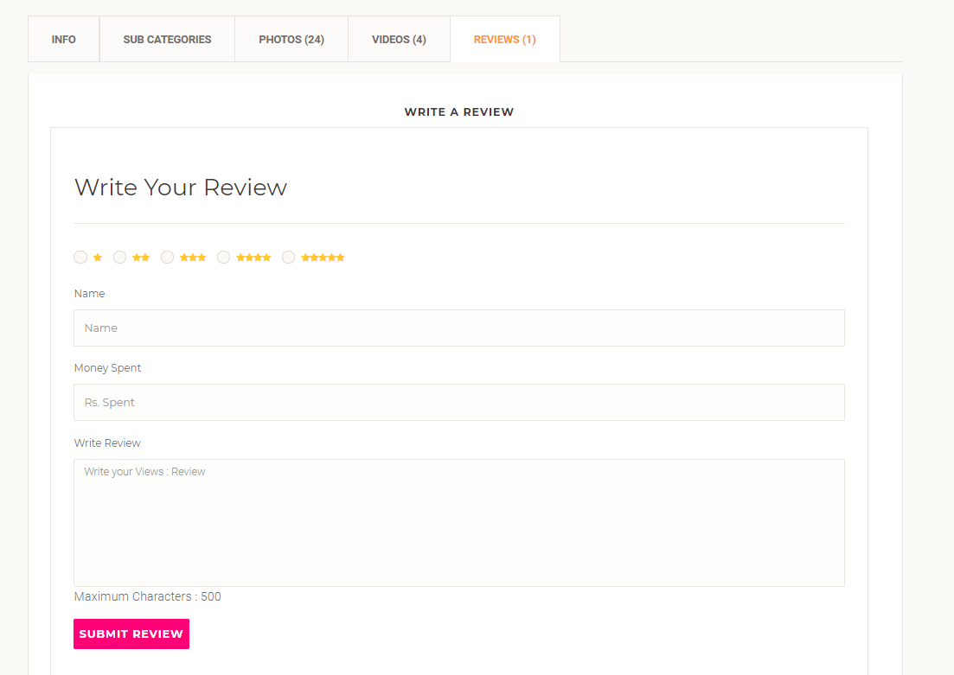
Vendor Profile Review Form

Slide 62
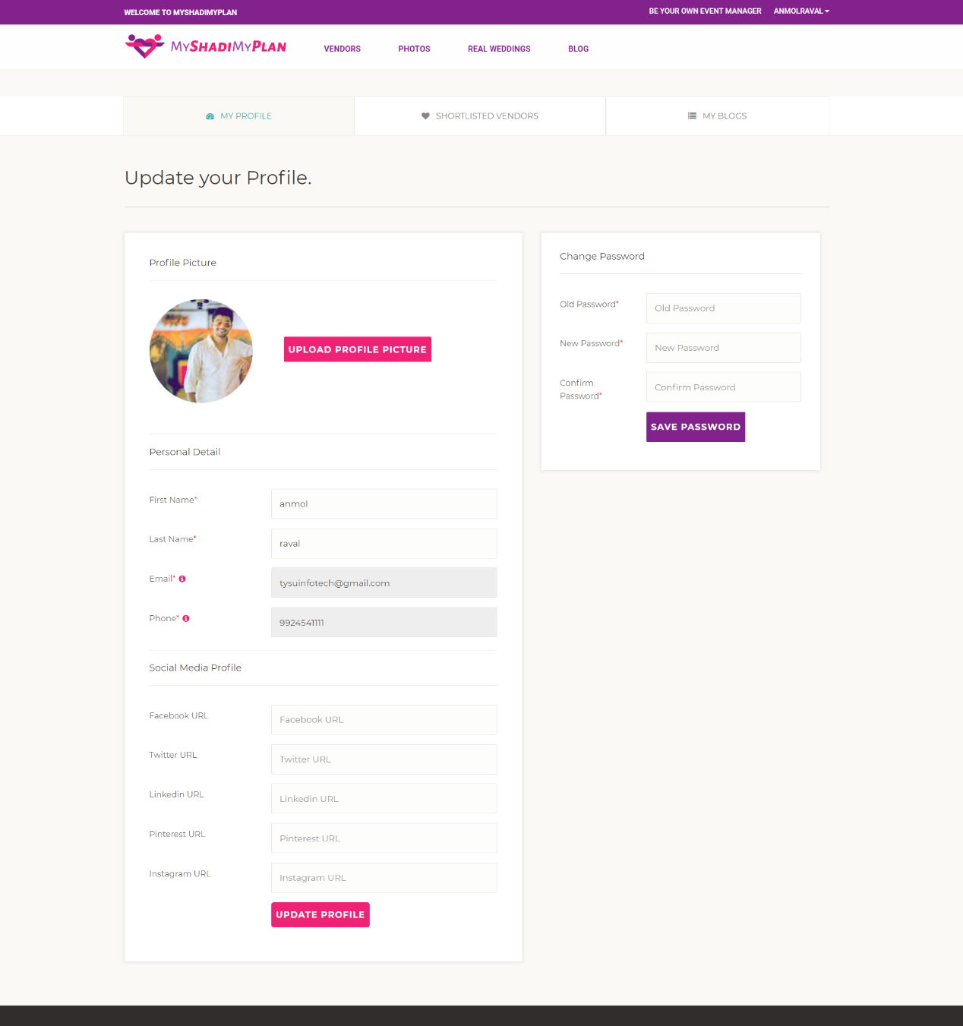
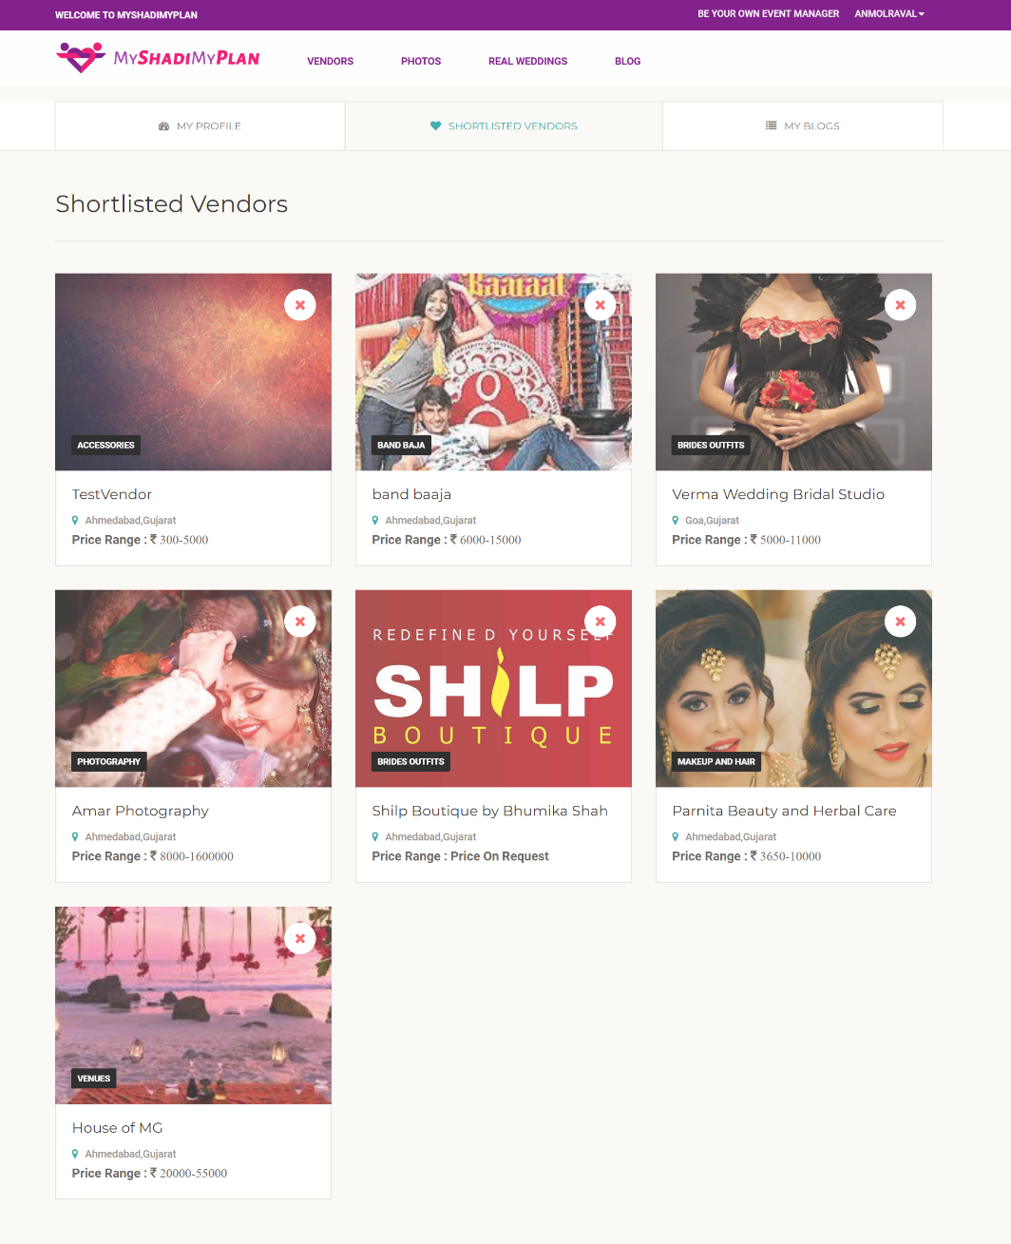

Slide 63
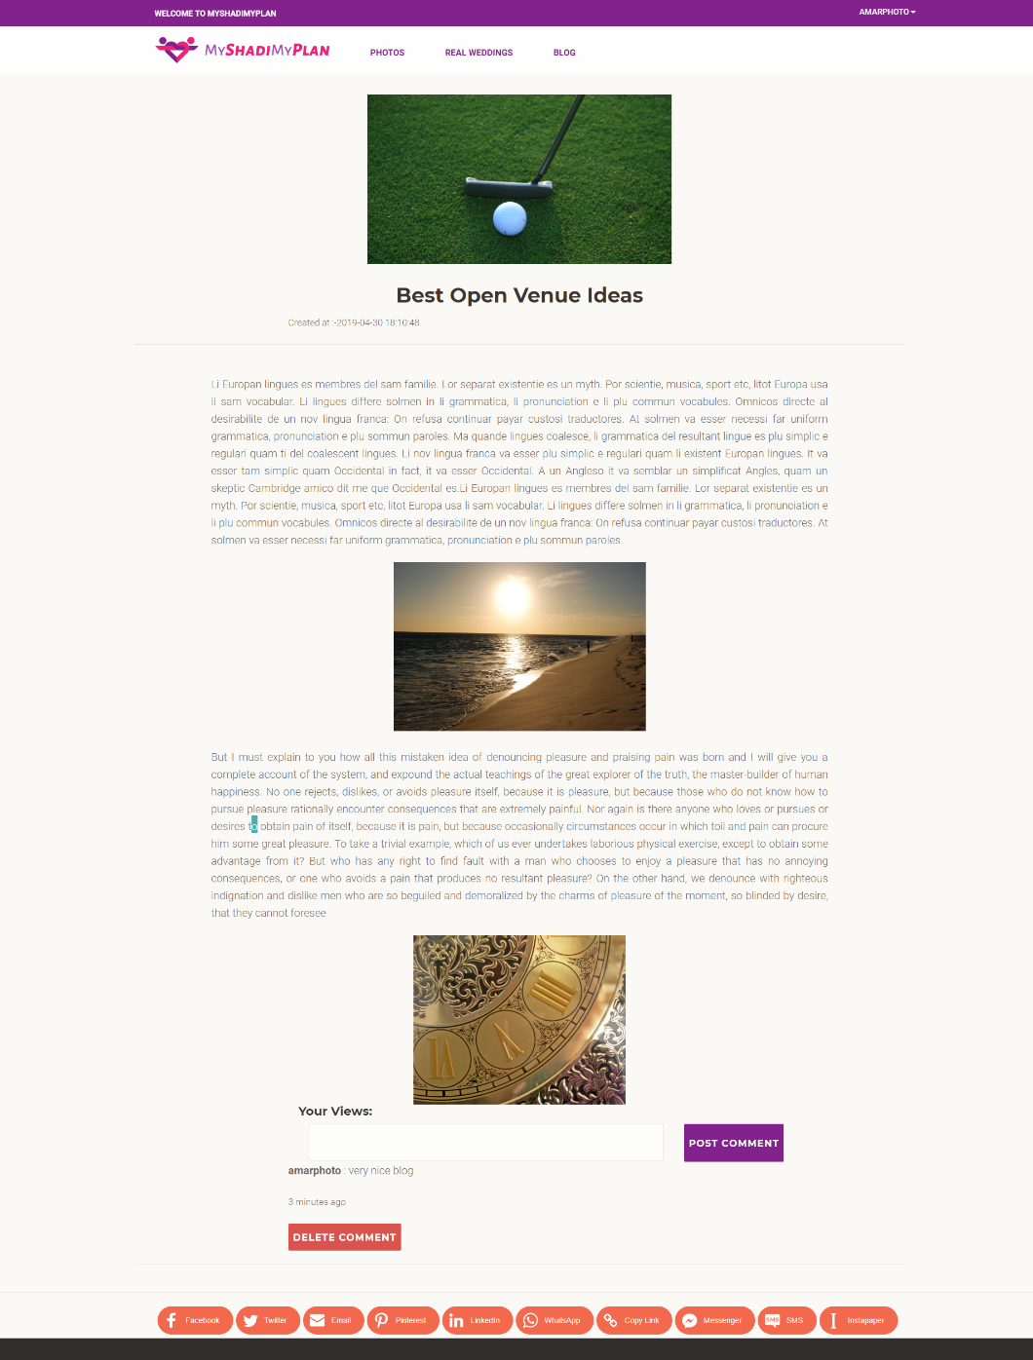
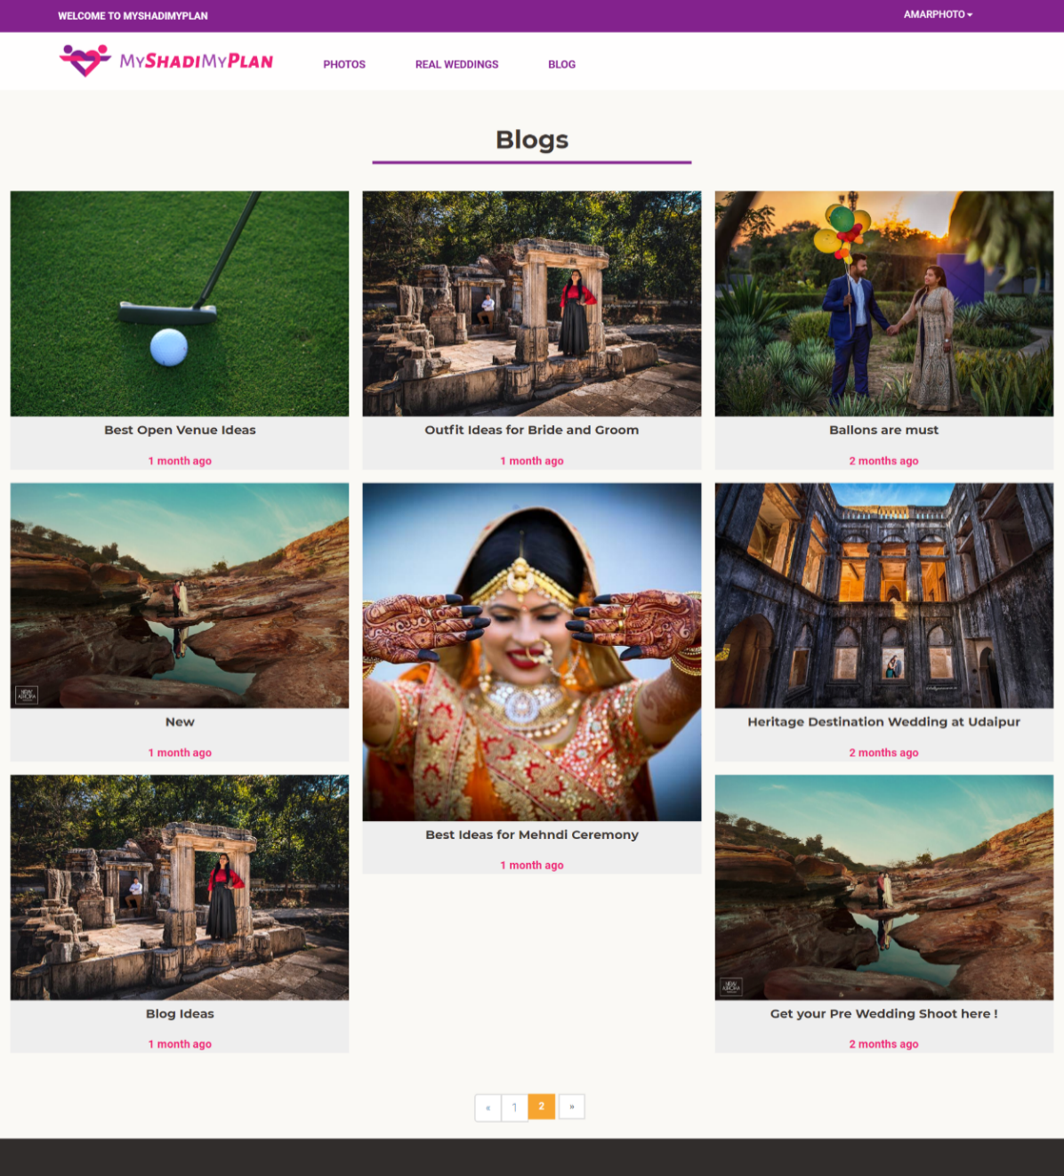
Blogs

Slide 64
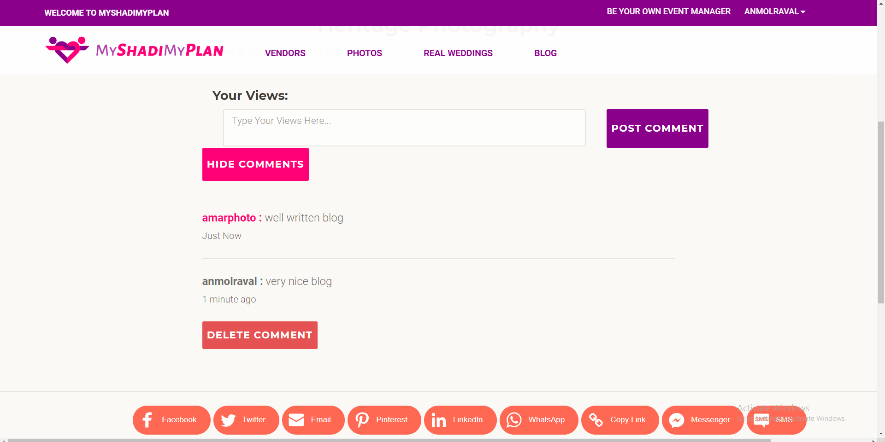
Comments in Blog

Slide 65
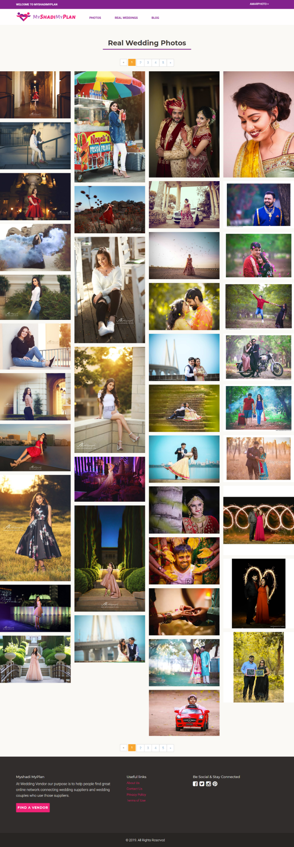
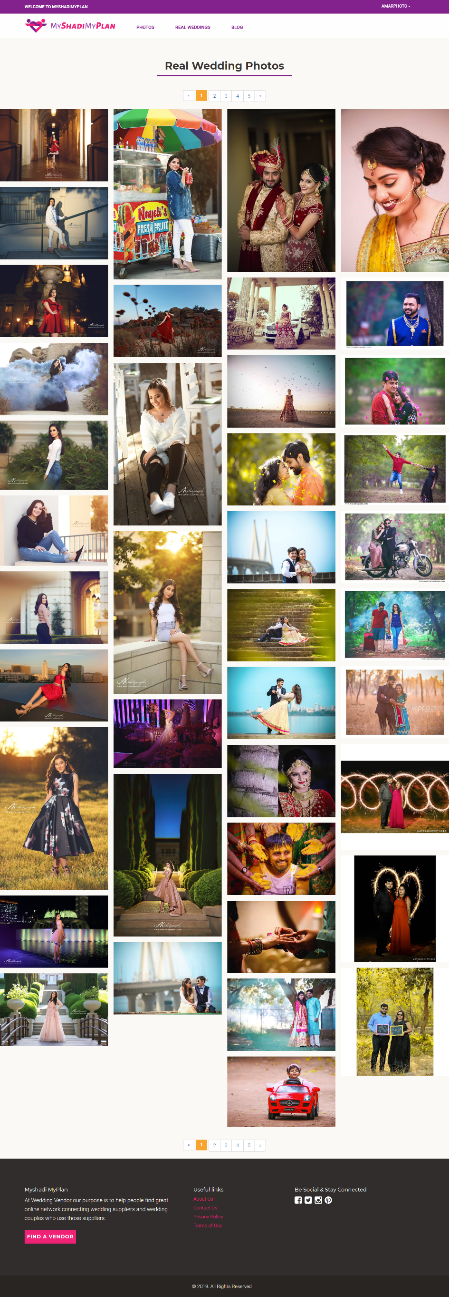
Browse Real Wedding photos

Slide 66
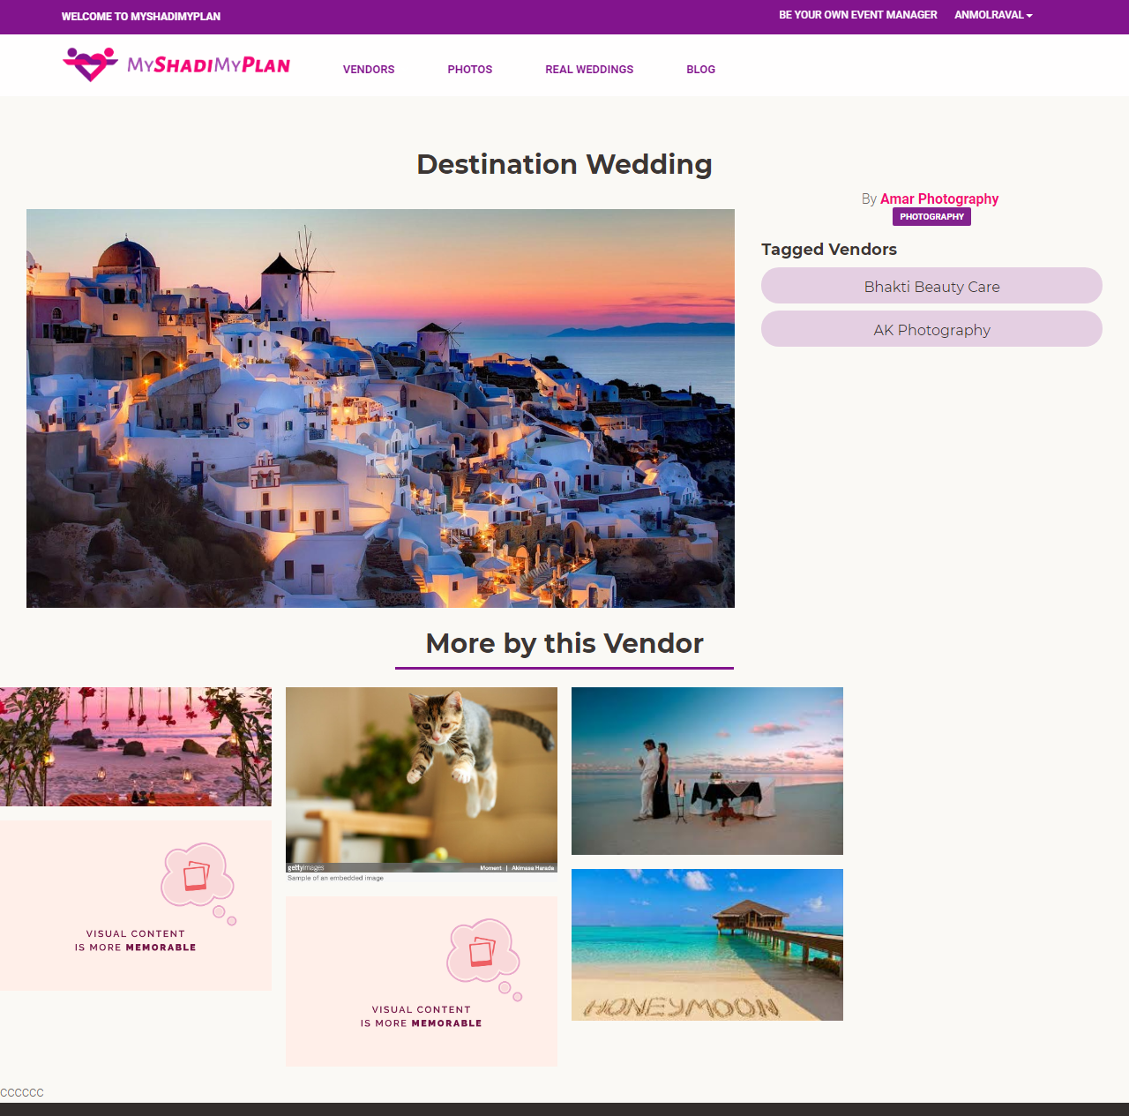

Slide 67
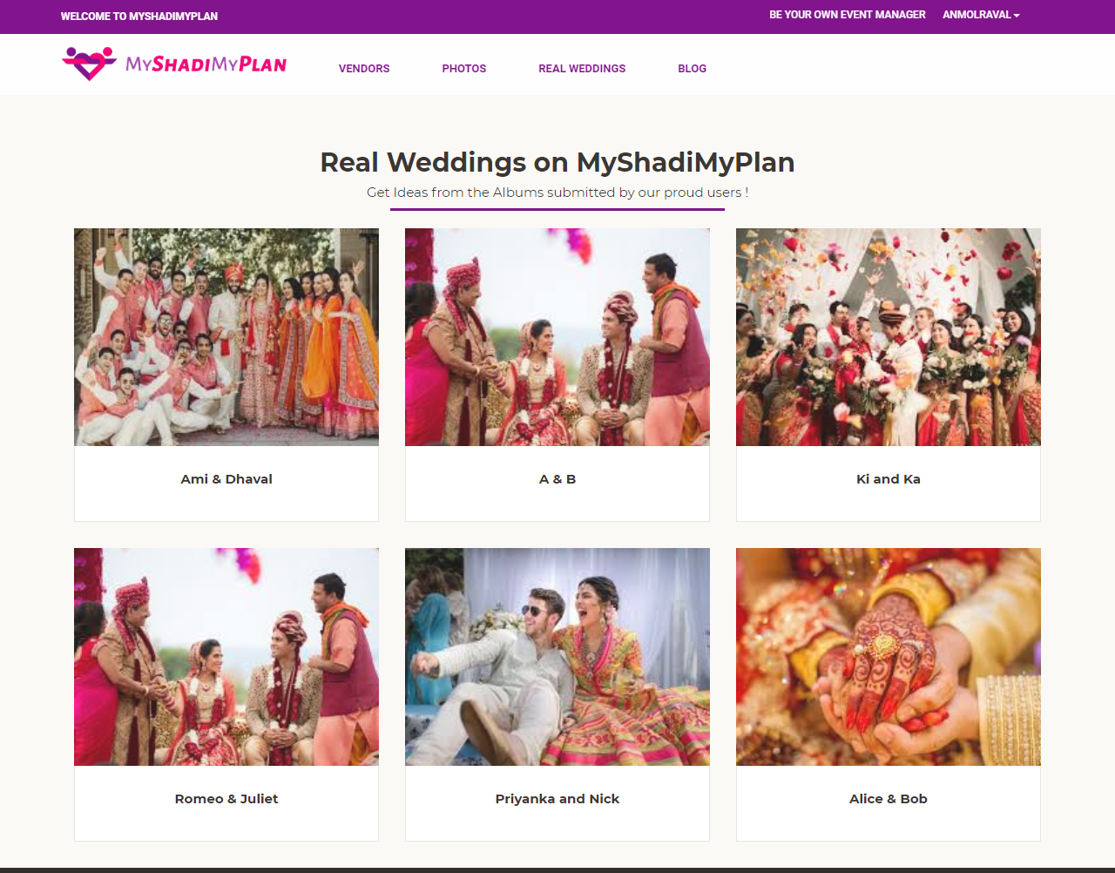
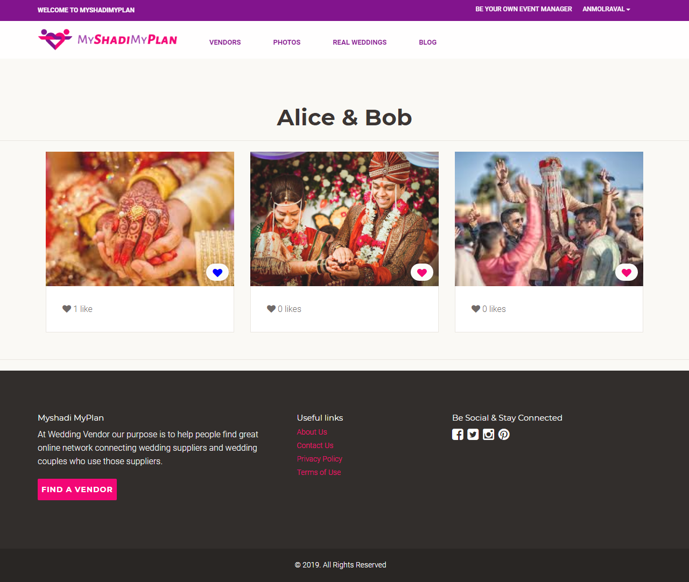
Browse Real Wedding Albums

Slide 68
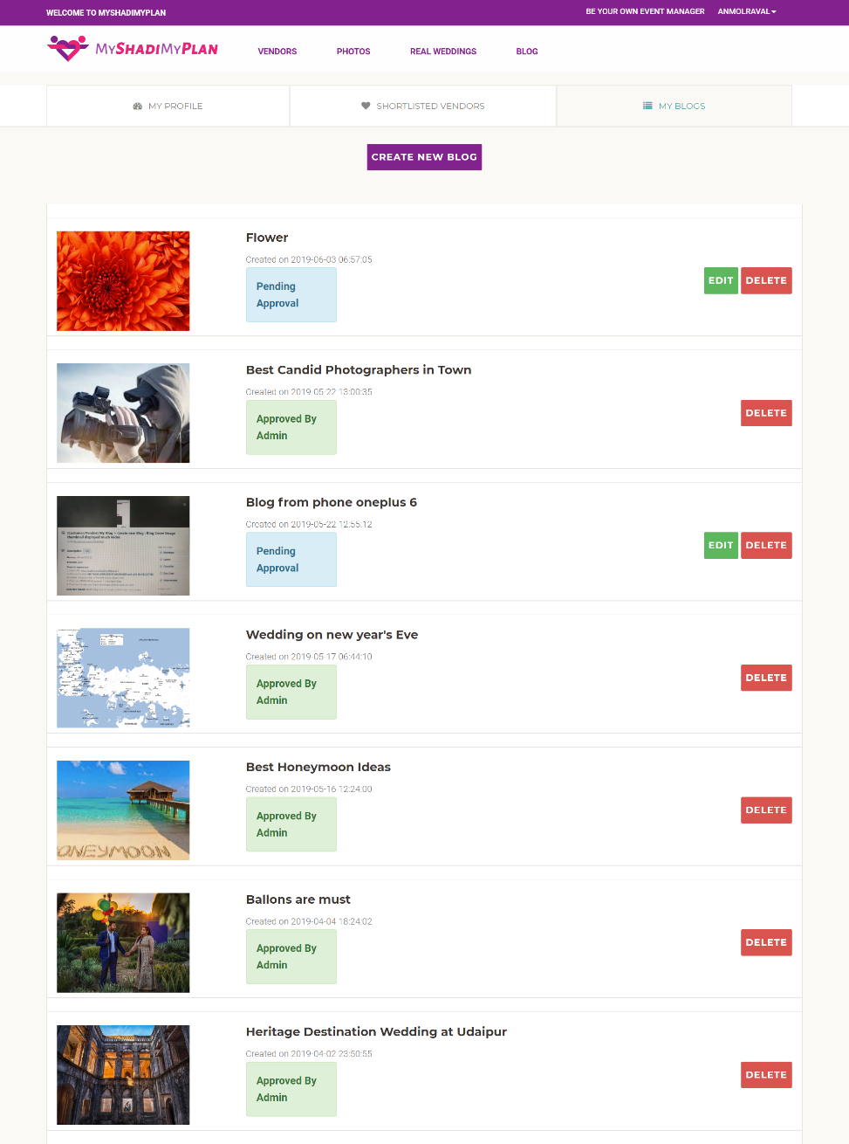
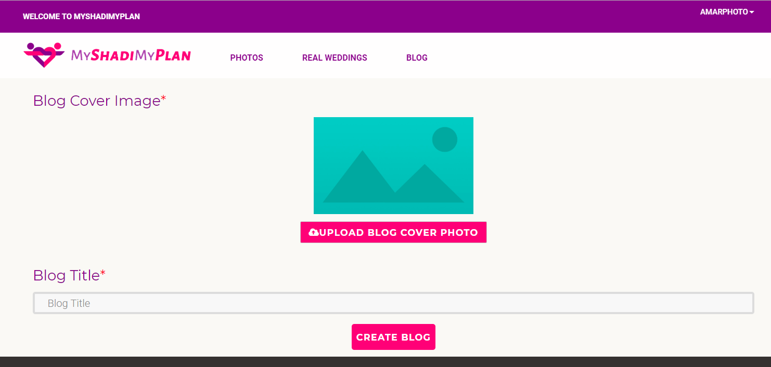
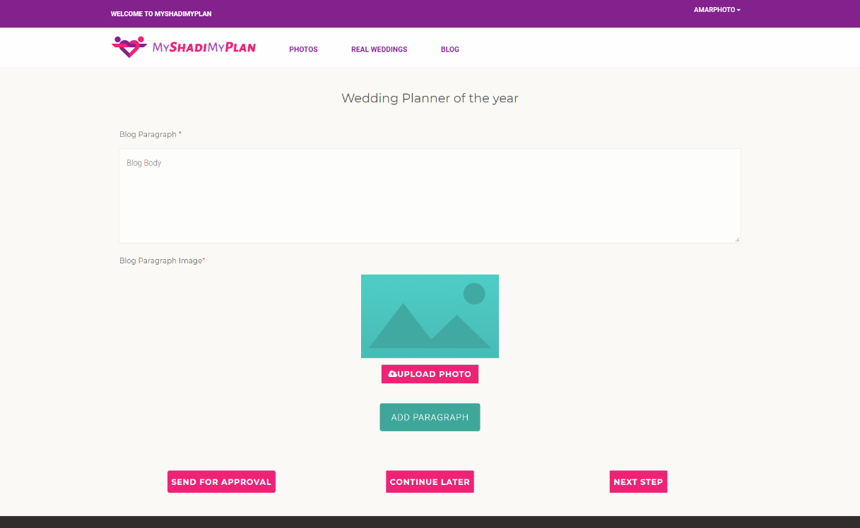
My Blogs & Create/Edit Blog

Slide 69
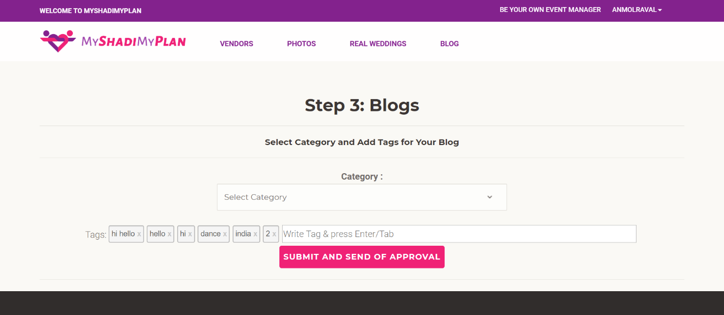
Tags in Blogs

Slide 70
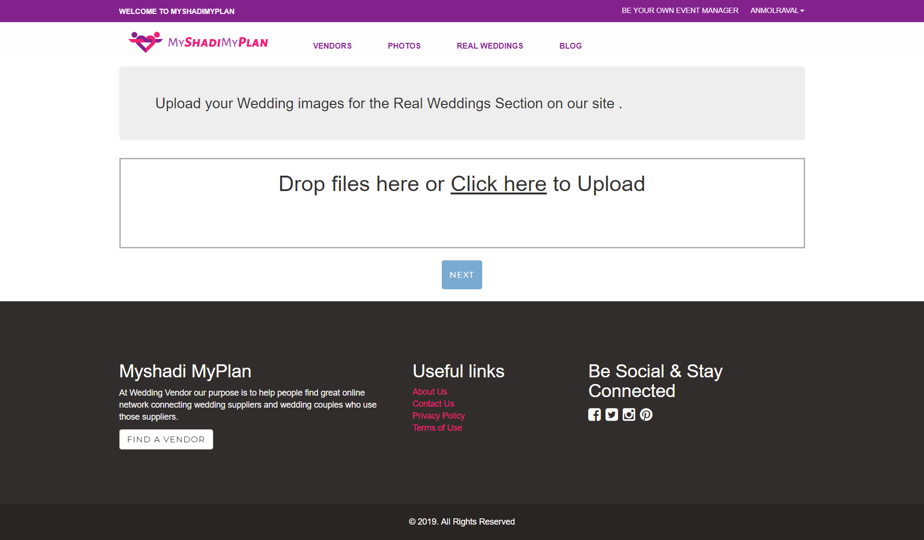

Real Wedding Album Creation

Slide 71
Vendor Side

Slide 72


Vendor Landing Page

Slide 73

OTP verification page

Slide 74

Vendor Account Creation

Slide 75



Slide 76


Slide 77

Vendor Dashboard

Slide 78




Graphs Generated

Slide 79


Shortlist Dashboard

Slide 80

Inquiry Dashboard

Slide 81


Slide 82


Edit Business Profile and Portfolio

Slide 83



Real Wedding Photos Dashboard

Slide 84

My Profile view

Slide 85
Admin Side

Slide 86

Admin Dashboard

Slide 87

Blogs

Slide 88

Blog approve

Slide 89


Real wedding approve

Slide 90
Testing
During development
Post development : 2 Iterations
Test Cases :
Customer user : 170 cases
Vendor user : 154 cases
Tools : Trello , google sheets

Slide 91
Future Enhancements
Implement vendor booking
Vendor membership packages
Promotional emails

